Slide 1

Notes:
Title Slide

Slide 2
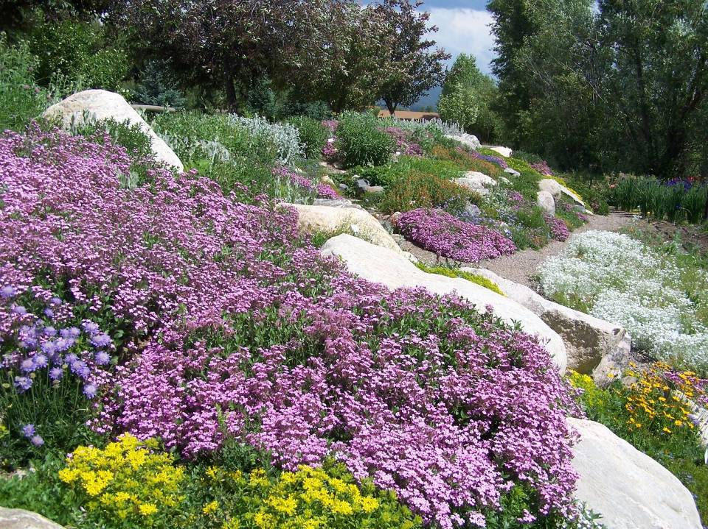

Herbaceous Plants
Right Plant, Right Place
Photo: David Whiting
Notes:
Photo: Yampa River Botanic Park, Steamboat Springs (David Whiting)

Slide 3
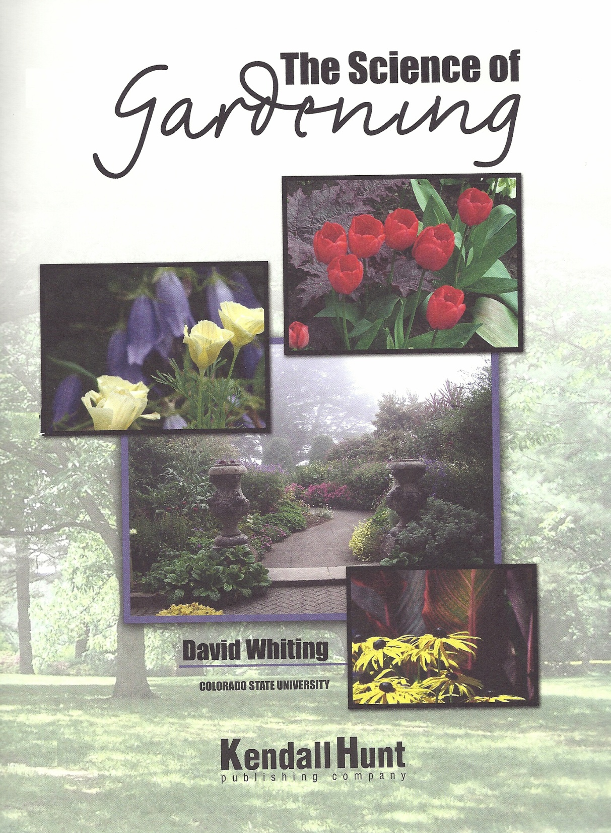
The Science of Gardening
Chapter 35, page 421
Herbaceous Plants (Flowers)

Slide 4
Page number
in textbook
421

Slide 5
Please hold questions for
Question Pause.
Ask questions clarifying points of discussion.
Notes:
5
Remind students
To hold questions to the question pause slide.
Questions asked during class time must be directly related to points of discussion.
Line drawing: Microsoft clipart

Slide 6
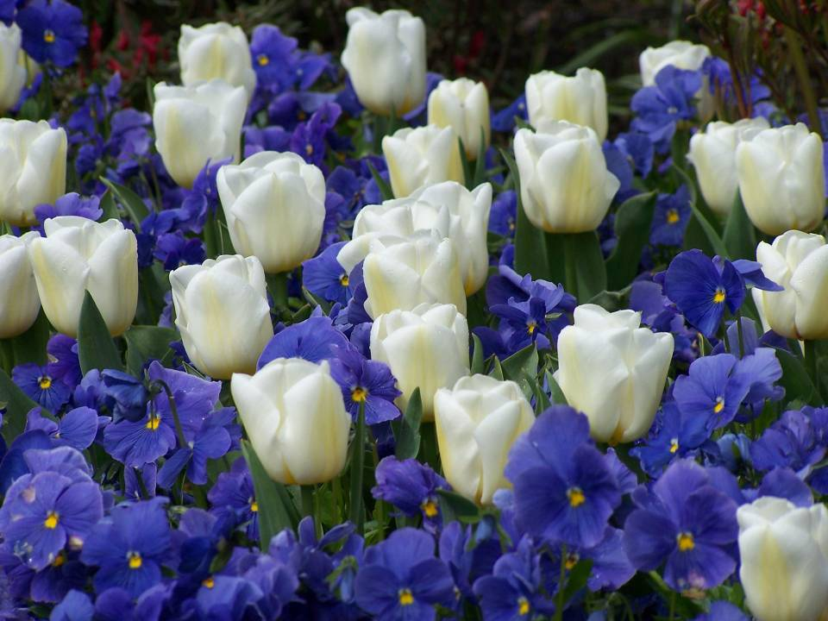
Class Objectives:
Questions to ask
  Evaluate plants for specific site
  Interpret catalog descriptions
421
Photo: David Whiting
Notes:
Picture: Butchart Botanic Gardens (David Whiting)

Slide 7
Class Outline
Climate and microclimate
  Colorado Ecoregions
  Hardiness and temperature
  Microclimate
10 minute break
Understanding catalog descriptions
  Life cycles
  Exposure (sun / shade requirements)
  Irrigation requirements
  Drought tolerance
  Soil requirements
10 minute break
Other considerations
Ecological adaptation

Slide 8
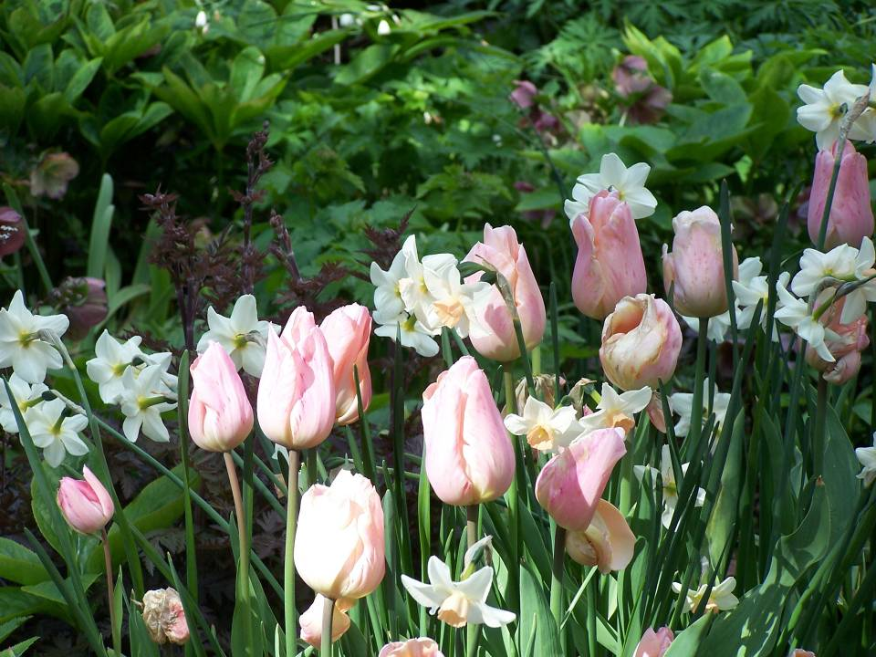
Climate
Microclimate
Photo: David Whiting
Notes:
Photo: Private Garden (David Whiting)

Slide 9
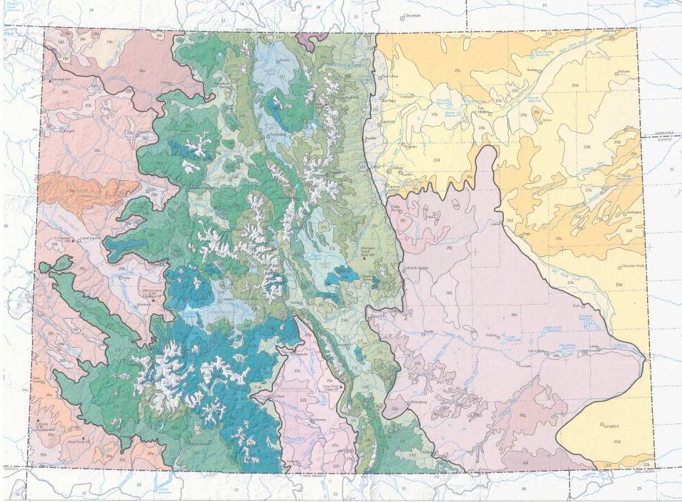
Colorado Ecoregions
511-2

Slide 10
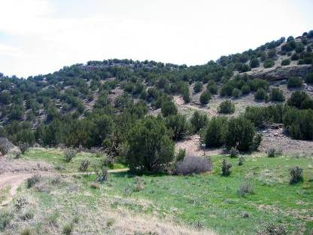
Colorado Ecoregions
Defined by dominant plant type, location and associations
  Alpine
  Coniferous forest
  Shrublands
  Grasslands
  Riparian
511-2
Notes:
Picketwire Canyon south of La Junta
Mix of grasslands on the flats and pinyon-juniper on the hillsides.
Part of Comanche Grasslands administered by US Forest Service.

Slide 11
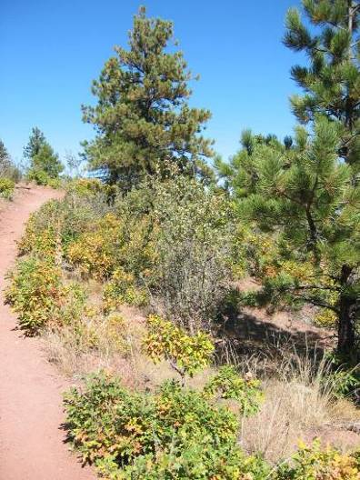
Survival Factors
  Length of growing season
  Range of temperature and precipitation
  Requirements for seed production and germination
511-2
Notes:
Photo was taken along Tower trail in the Pueblo Mountain Park, Beulah, CO, 7,000 feet
Dry, southwest facing slope
Shrub oak, mountain mahogany, various grasses and herbaceous perennials mixed with Ponderosa pines and occasional Pinyon.
Ecosystems have changed as fire has been suppressed.
Pinyon and Ponderosa pines need bare ground and light to germinate. Douglas-fir germinates in shady areas.

Slide 12
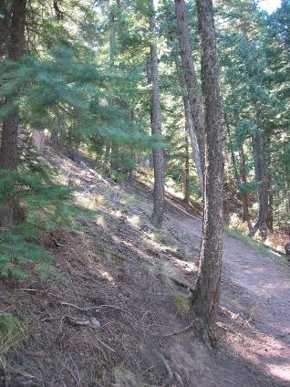
Survival Factors
Ability to coexist or
out compete
    Early blooming perennials complete reproductive cycle before warm season grasses reach full height
    Douglas-fir populations shade soil, reducing competition from understory
511-2
Notes:
Photo was taken along Tower trail in the Pueblo Mountain Park, Beulah, CO, 7,000 feet
Dry, southwest facing slope
Shrub oak, mountain mahogany, various grasses and herbaceous perennials mixed with Ponderosa pines and occasional Pinyon.
Ecosystems have changed as fire has been suppressed.
Pinyon and Ponderosa pines need bare ground and light to germinate. Douglas-fir germinates in shady areas.

Slide 13
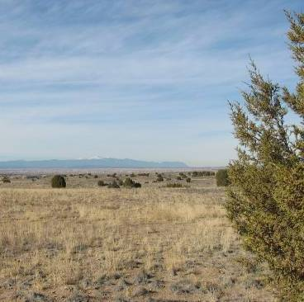
Prairie Grasslands
  Many sites disturbed by human use
  Trees rare
  Climate
    Dry, warm summer
    Windy, dry winter
    Fire common
  Blend with coniferous
  or deciduous forest
  at base of mountains
Photo: Linda McMulkin
511-2
Notes:
Photo from the Pueblo Reservoir, looking north toward Pikes Peak. Short grass prairie, with Sabina monosperma, prickly pear cactus, spring blooming forbs
Precipitation less than 20 inches per year

Slide 14
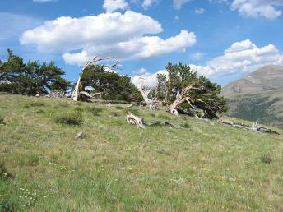
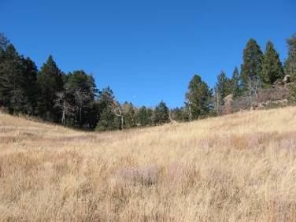
Mountain Grasslands
  Interspersed with forest stands
  Dominated by herbaceous perennials
  Occur in areas not favorable for tree growth
  Elevations range from foothills to alpine
Timberline
8,500 feet
511-2
Notes:
Lyon Park, south of Canon City

Slide 15
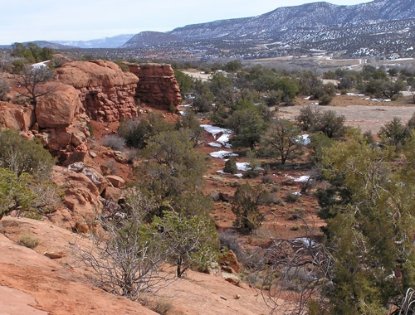
Shrublands
Many different climates possible
    Montane
      5,500 to 10,000 feet
      Dominant plants vary
    Sagebrush
      Western slope
      Multiple elevations
    Semi desert
      5,000 to 8,000 feet
      Drought tolerant plants
511-2

Slide 16
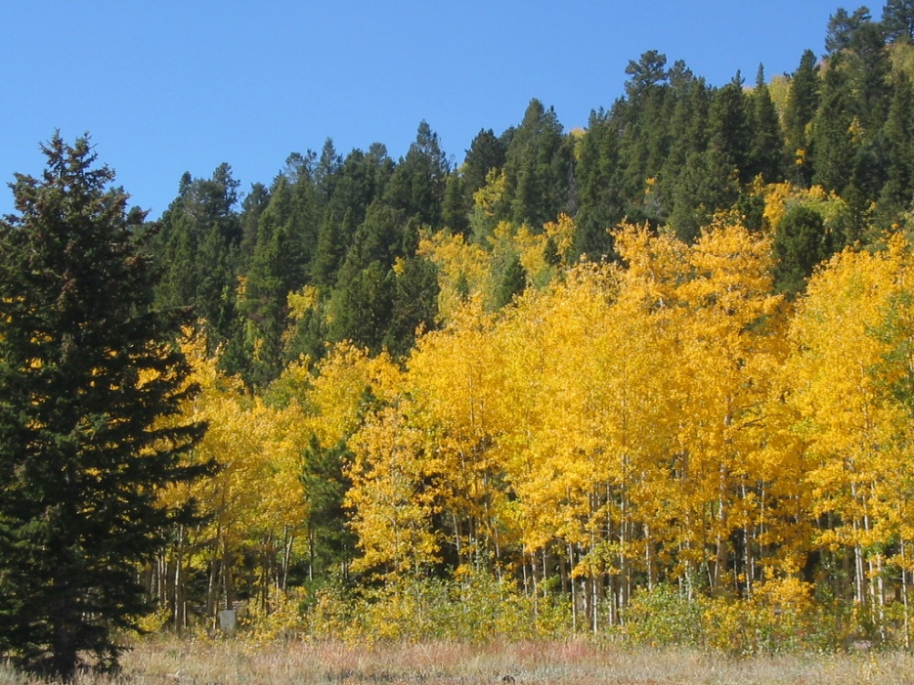
Coniferous Woodlands and Forests
  Plant population at various elevations depends on
    Slope
    Exposure
    Soil types
    Precipitation
    Temperature
511-3

Slide 17
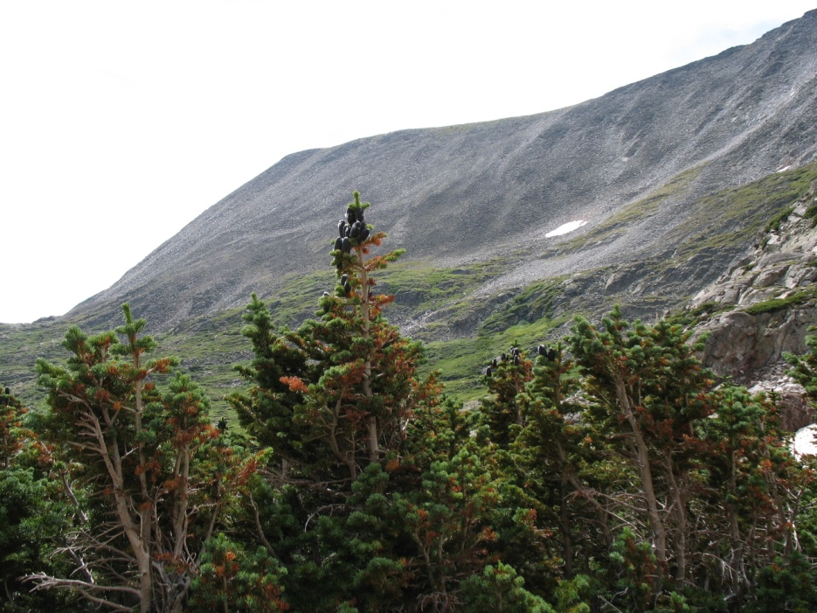
Coniferous Woodlands and Forests
  Plant population at various elevations
    Subalpine
      8,500 to timberline
    Mid elevation
      5,500 to 9,000 feet
    Lower elevation
      5,000 to 8,000 feet
511-3

Slide 18
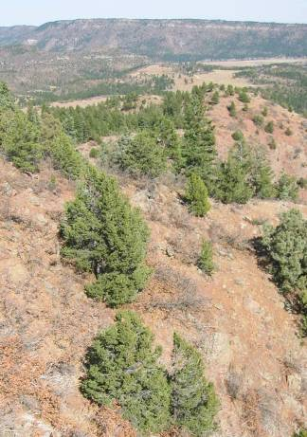
Low Elevation Woodlands
  Transition zone between
  grassland and mountain forest
  Dominant species
    One-seed Juniper
    Rocky Mountain Juniper
    Utah Juniper
    Piñon Pine
    Ponderosa Pine
  Herbaceous ground cover
  sparse
511-3

Slide 19
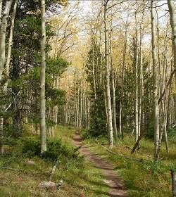
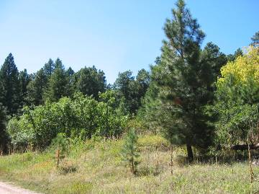
Mid-Elevations Forests
  Ponderosa pine and
  Douglas-fir
  Interspersed with aspen
  and various shrubs
  Climate ranges from
  hot/dry to cool/moist
  Tend to have diverse populations
Photo: Linda McMulkin
Photo: Linda McMulkin
511-3
Notes:
Dominant plant determined by exposure and soil type

Slide 20
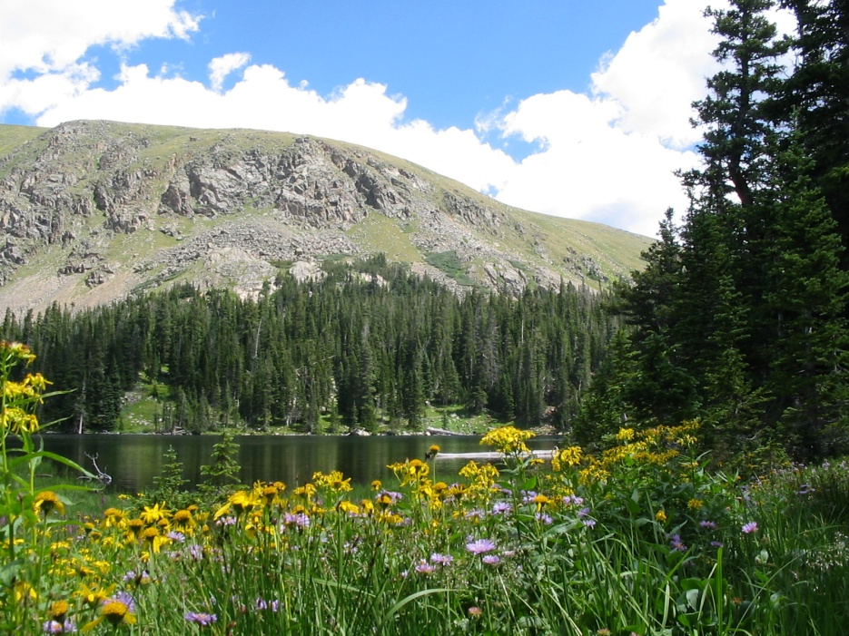
Subalpine Forests
  Climate cool and moist with short growing season
  Wind, sun and snowpack impact dominant community
  Species
    Lodgepole, limber,
    & bristlecone pine
    Englemann spruce
    Subalpine fir
  Less diversity than
  other elevations
511-4

Slide 21
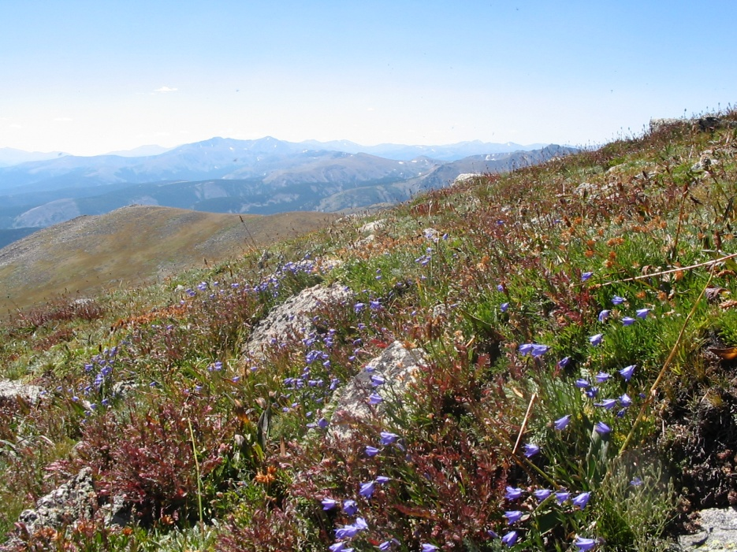
Alpine
  Very short growing season
  Most precipitation falls as snow
  Herbaceous plants
  dominant with some
  stunted woody plants
511-4
Notes:
Wet Mountains, near Westcliffe, above timberline, mid August. Fog was moving up the mountains and spilling over the rocks.

Slide 22
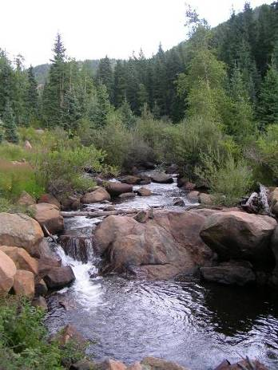
Riparian
  Depends on nearly continuous water supply
  Cold air drains into low areas
  Shorter growing season than surrounding hills
  Deciduous trees common
Photo: Linda McMulkin
511-5
Notes:
Beaver Creek, south east of Cripple Creek
Willows, red-osier, chokecherry

Slide 24
Small Group Discussion
What Ecoregions are found in
this area?
What variations do you find in
the local Ecoregions?

Slide 25

The Science of Gardening
Chapter 35, page 421
Herbaceous Plants (Flowers)
Notes:
25
Reference slide to CMG GardenNotes

Slide 26
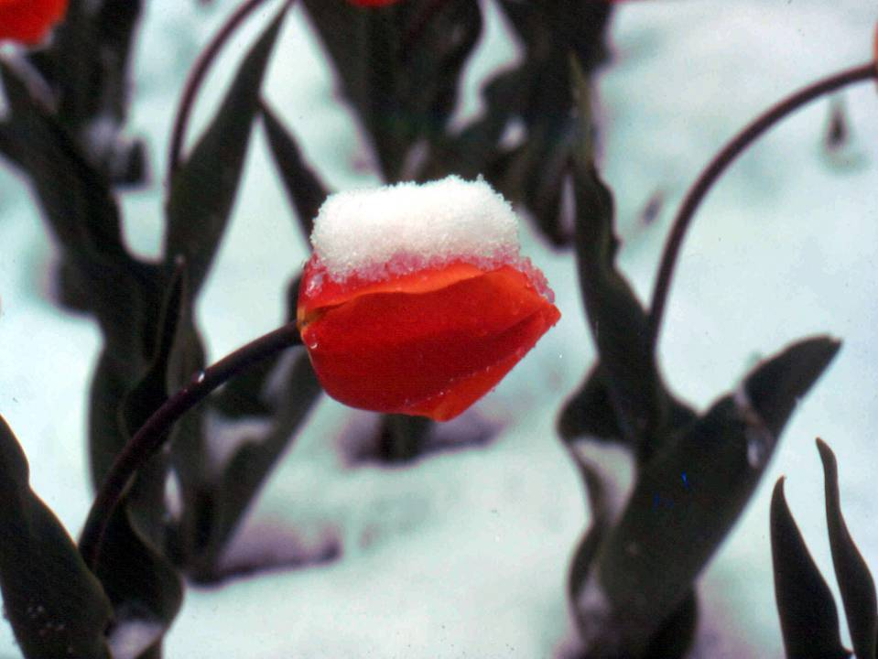
Hardiness
Temperatures
421
Notes:
Photo: Tulip in Snow by Jeffry de Jong

Slide 27
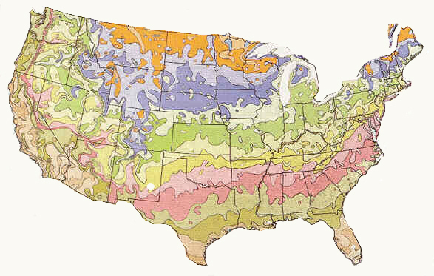
USDA Hardiness Zones
Introduced in 1960
  Based on the average minimum temperature
  Zones based on 10⁰ F differences
  Extreme low temperatures not included
Revised in 1990
  Based on data from
  1974-1986
  Divided zones into A and B
  Introduced zone 11 (frost-free)
421

Slide 28
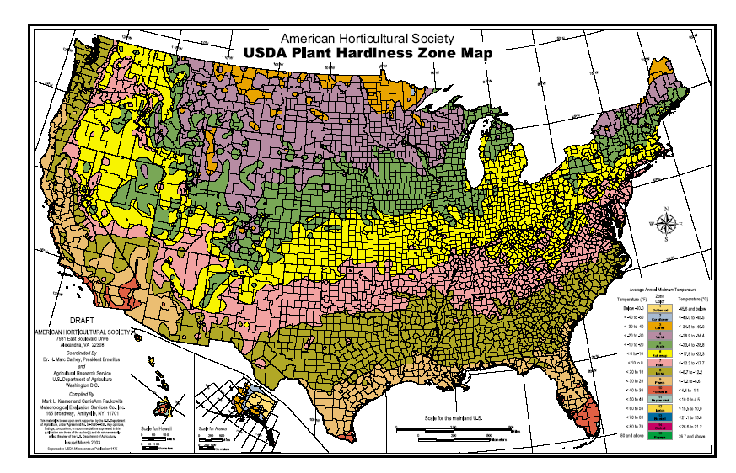
USDA Miscellaneous Publication No. 1475, Issued January 1990

Slide 29
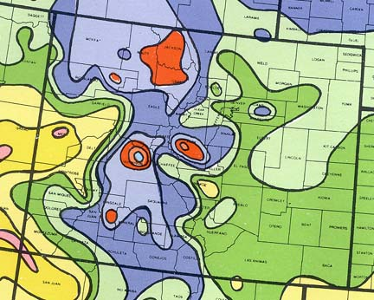
Colorado
Average Annual Minimum Temperatures
Zone 3: -30⁰ to -40º
Zone 4: -20° to -30°
Zone 5: -10° to -20°
Zone 6: 0° to -10°
422

Slide 30
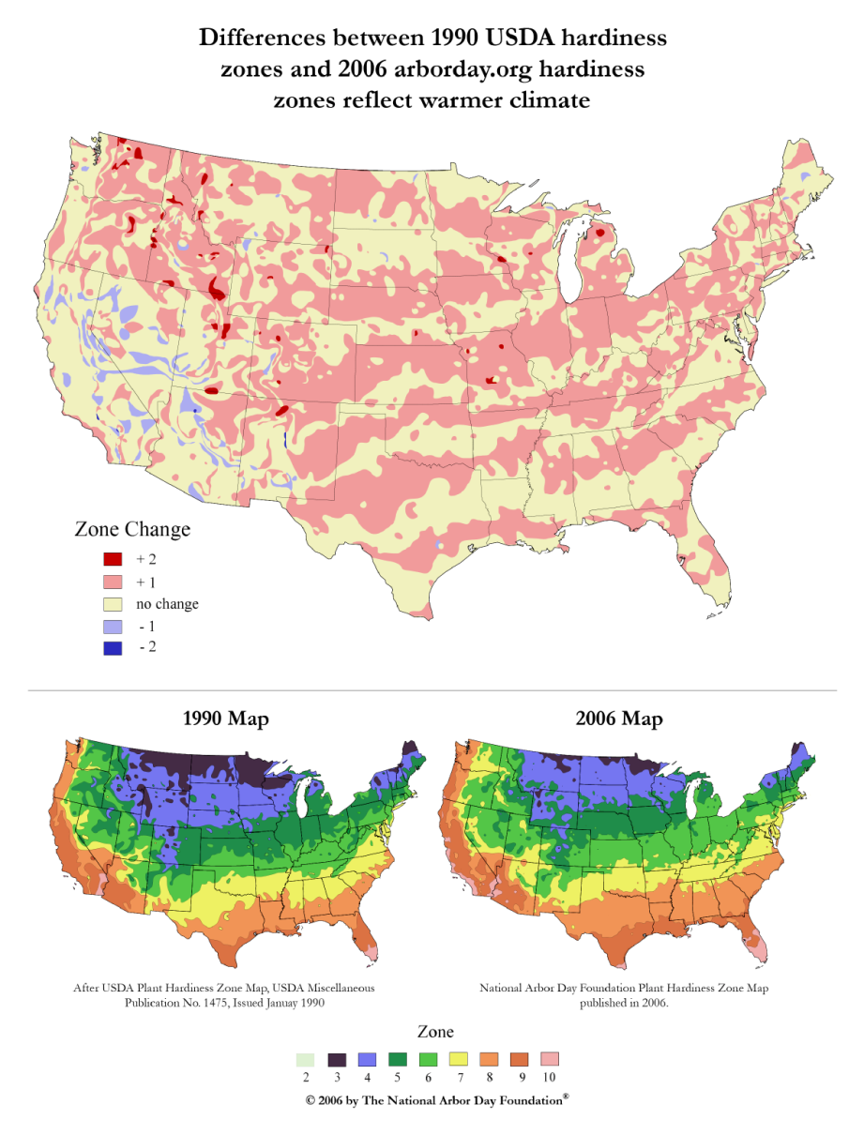
Is the climate is getting warmer?
Zone creep from 1960 to 1990
In part due to limited time period used in data

Slide 31
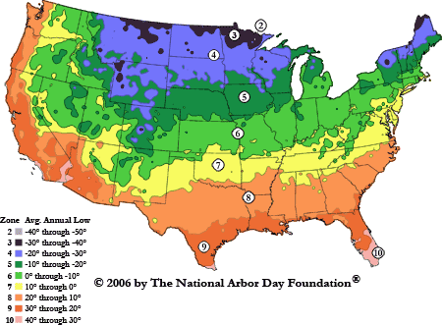
2006 Arbor day revised map based on temperature data from 1986 - 2002

Slide 32
Is the climate is getting warmer?
Difference based on years used in data selection

Slide 33
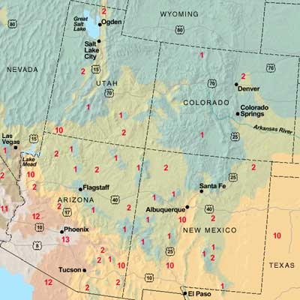
Sunset Climate Zones
Their claim:
Climate zones take into account the total climate:
  Length of growing season
  Timing and amount of rainfall
  Winter lows
  Summer highs
  Humidity
422

Slide 34
Sunset Climate Zones
Notes:
Colorado only has three??

Slide 35
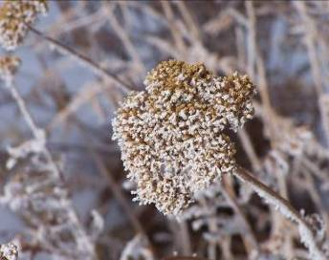
Hardiness zone maps should not entirely dictate plant choice.
Limited meaning for perennials (dormant in winter)
Take your “zone” with a grain of salt
  If you really want a plant,
  try it at least three times
  (in different microclimates)
  before giving up.
421

Slide 36
Factors that Influence Hardiness
Minimum temperature
Recent temperature patterns
Water supply
Wind and sun exposure
Genetic makeup
Carbohydrate reserves
421

Slide 37
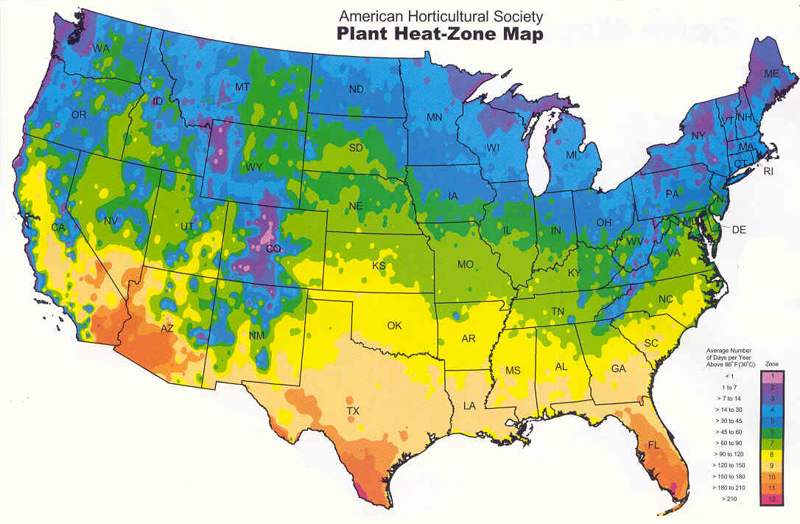
Heat Zone Map – the Other Extreme
422

Slide 38
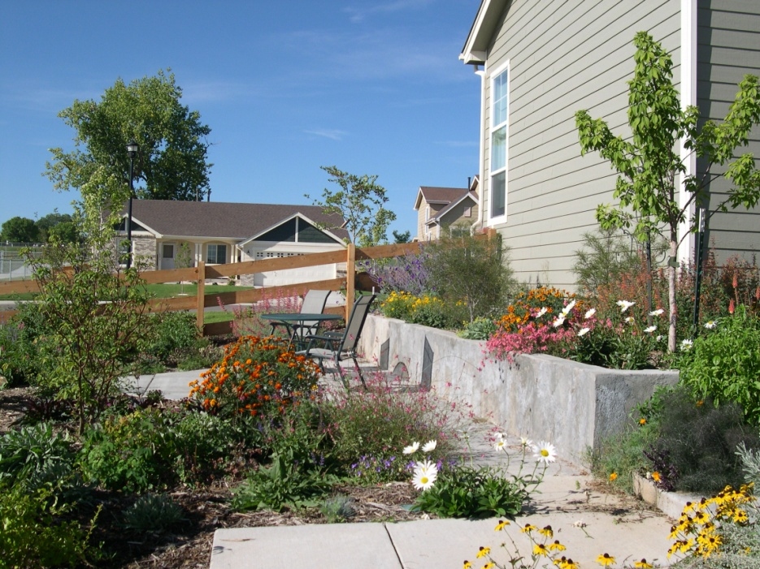
Heat Tolerance
Other heat sinks
  Stone
  South-facing wall
  Driveway
422

Slide 39
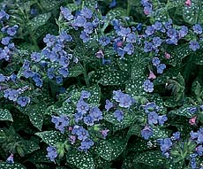
Heat Tolerance
In hot areas, avoid plants described as
  “Not a good choice for Desert Southwest”
  “Falters in torrid summers”
  “Melts out in the heat”
422
Photo: WFF
Notes:
39

Slide 41
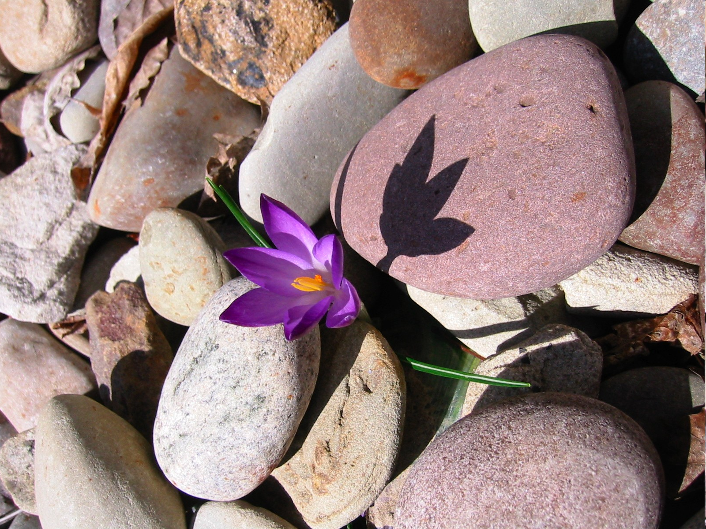
Microclimates
422
Photos: www.kgraff.net
Notes:
Photo: Aspect (Irene Shonle)

Slide 42
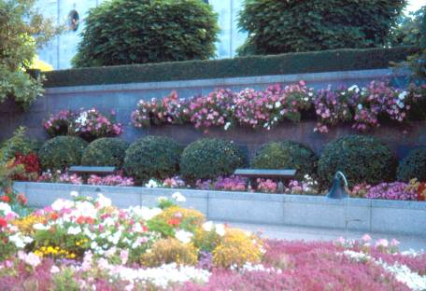
Microclimates
Variations within a specific location
May differ significantly from the general climate of a region
Heat storing of hardscapes = longer growing season
422
Notes:
Photo: Gardens around this heat sink of stone walls, planters and sidewalks has a 2 month longer growing season than surroundings (Salt Lake City, UT) (David Whiting)

Slide 43
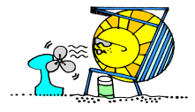

Microclimates
Influenced by
  Elevation
  Aspect (north/south orientation)
  Hills and hollows (air drainage)
  Rocks (heat sinks)
  Structures
  Bodies of water
422
Artwork: David Whiting

Slide 44
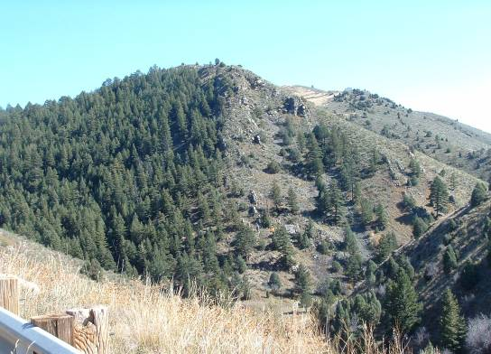
Microclimate
Aspect
South slope versus north slope
422
Photo: Irene Shonle
Notes:
Photo: Aspect (Irene Shonle)

Slide 45
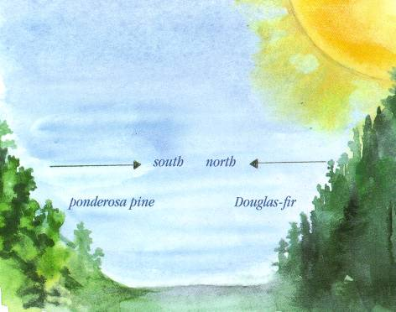
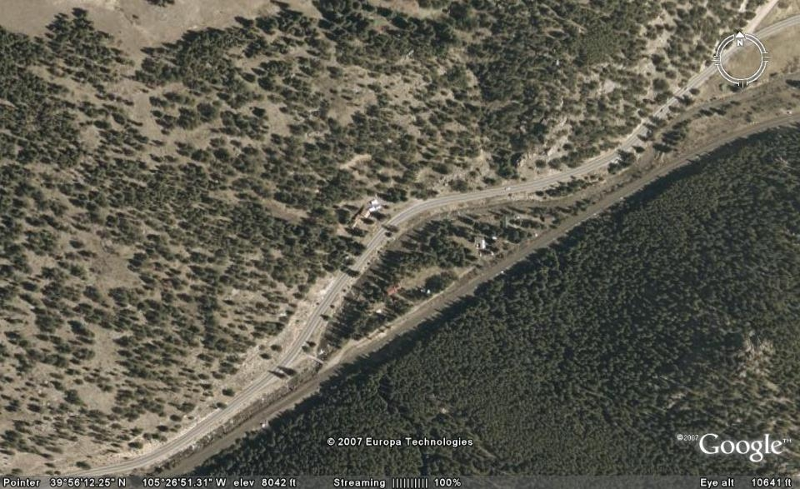
Microclimate
Aspect
Different sides of a
valley have very
different microclimates.

Slide 46
Microclimate
Drainage
  Valleys are cooler than hillsides
    At night, cool air drains to low spots.
    Valley floors may be over 10º F cooler than surrounding gardens on hillsides above the valley floor
COLD
Warmer
COLD
422

Slide 47
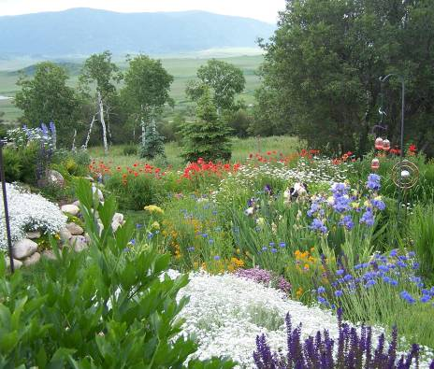
Microclimate
Drainage
Air drainage and aspect may change growing season by 1-2 zones and blooming by 2-6 weeks.
422
Notes:
Photo of CMG Volunteer’s garden near Steamboat Springs. Since this garden is up off the valley floor it has a much longer frost free period than gardens down in Steamboat Springs. (David Whiting)

Slide 48
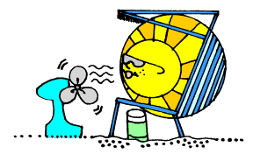
Microclimate
Learn to create and
exploit microclimates
north facing exposure south facing exposure
422

Slide 49
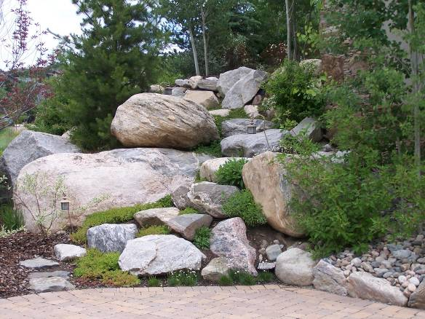
Microclimate
Warmer microclimate with large rocks
as heat sink
422
Notes:
Photo: Heat sink with rock give this garden a warm microclimate (Steamboat Springs) (David Whiting)

Slide 50
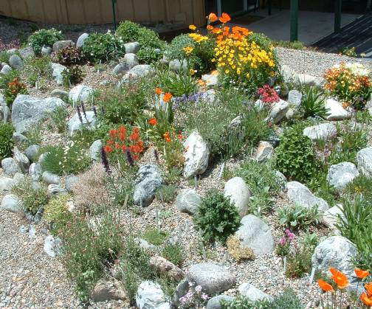
Warmer microclimate created by south facing sloped raised bed
Microclimate
422

Slide 51
Microclimate
On different sides of the house
Full sun to part shade
North
Shady, cool
Hot, dry
422

Slide 52
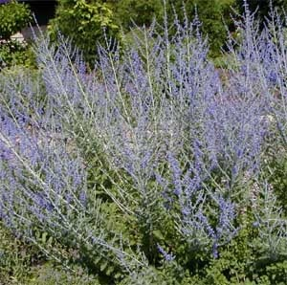
South and west-facing microclimate
Microclimate
Cold-tender plants
Need more heat to bloom
422

Slide 53
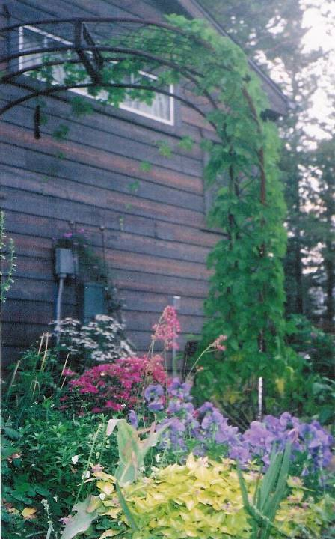
Microclimate
East side of house
  Cooler than South or West
  May be more protected from wind
  Perhaps most temperate side of house
422

Slide 54
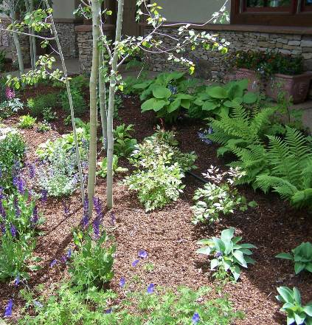
Microclimate
North side of house
  Cooler
  May be moister
422
Photo: David Whiting
Notes:
Photo: Private Garden, Steamboat Springs (David Whiting)

Slide 55
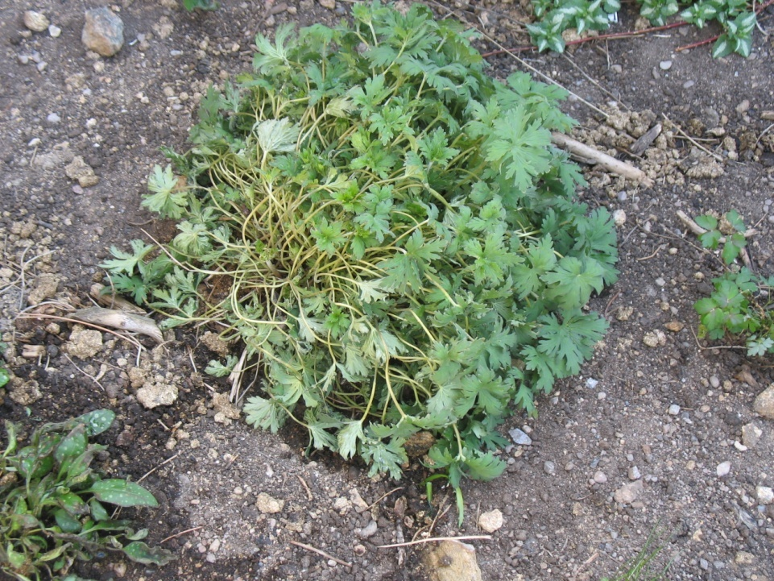
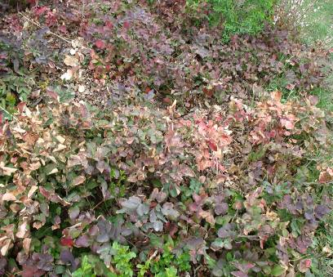
Microclimate
Wind
  Gusts up to 100 mph common
  Desiccate plants
  Increases plant mortality
  Blows away mulch
422

Slide 56
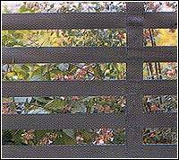
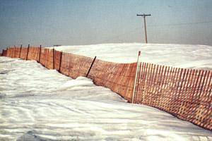
Microclimate
If you are in a windy spot
  Plant plants that tolerate wind
  OR
  Create a windbreak (a density of 40% to 60% provides the greatest downwind area of protection)

Slide 57
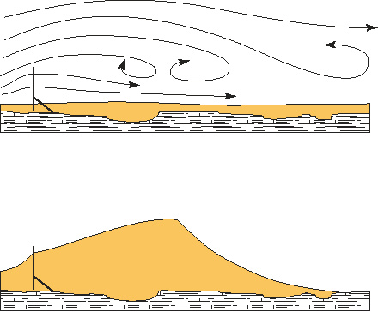
Microclimate
If you create or have an existing windbreak, take advantage:
Snow piling up on the lee side of a windbreak creates a blanket
Plant more tender plants here
423

Slide 59
Small Group Discussion
Talk about a situation in which you succeeded in exploiting a microclimate.
OR a time when you planted in the wrong microclimate.
Notes:
59

Slide 60

Break Time
10 minutes remaining
Notes:
Break timer – set to auto-advance in 1 minutes
HOWEVER, check that it is working on the computer being used.
Line drawing: Microsoft clipart

Slide 61
Break Time
9 minutes remaining
Notes:
Break timer – set to auto-advance in 1 minutes
HOWEVER, check that it is working on the computer being used.
Line drawing: Microsoft clipart

Slide 62
Break Time
8 minutes remaining
Notes:
Break timer – set to auto-advance in 1 minutes
HOWEVER, check that it is working on the computer being used.
Line drawing: Microsoft clipart

Slide 63
Break Time
7 minutes remaining
Notes:
Break timer – set to auto-advance in 1 minutes
HOWEVER, check that it is working on the computer being used.
Line drawing: Microsoft clipart

Slide 64
Break Time
6 minutes remaining
Notes:
Break timer – set to auto-advance in 1 minutes
HOWEVER, check that it is working on the computer being used.
Line drawing: Microsoft clipart

Slide 65
Break Time
5 minutes remaining
Notes:
Break timer – set to auto-advance in 1 minutes
HOWEVER, check that it is working on the computer being used.
Line drawing: Microsoft clipart

Slide 66
Break Time
4 minutes remaining
Notes:
Break timer – set to auto-advance in 1 minutes
HOWEVER, check that it is working on the computer being used.
Line drawing: Microsoft clipart

Slide 67
Break Time
3 minutes remaining
Notes:
Break timer – set to auto-advance in 1 minutes
HOWEVER, check that it is working on the computer being used.
Line drawing: Microsoft clipart

Slide 68
Break Time
2 minutes remaining
Notes:
Break timer – set to auto-advance in 1 minutes
HOWEVER, check that it is working on the computer being used.
Line drawing: Microsoft clipart

Slide 69
Break Time
1 minute remaining
Notes:
Break timer – set to auto-advance in 1 minutes
HOWEVER, check that it is working on the computer being used.
Line drawing: Microsoft clipart

Slide 70

Please take your seats, ready to continue class

Slide 71
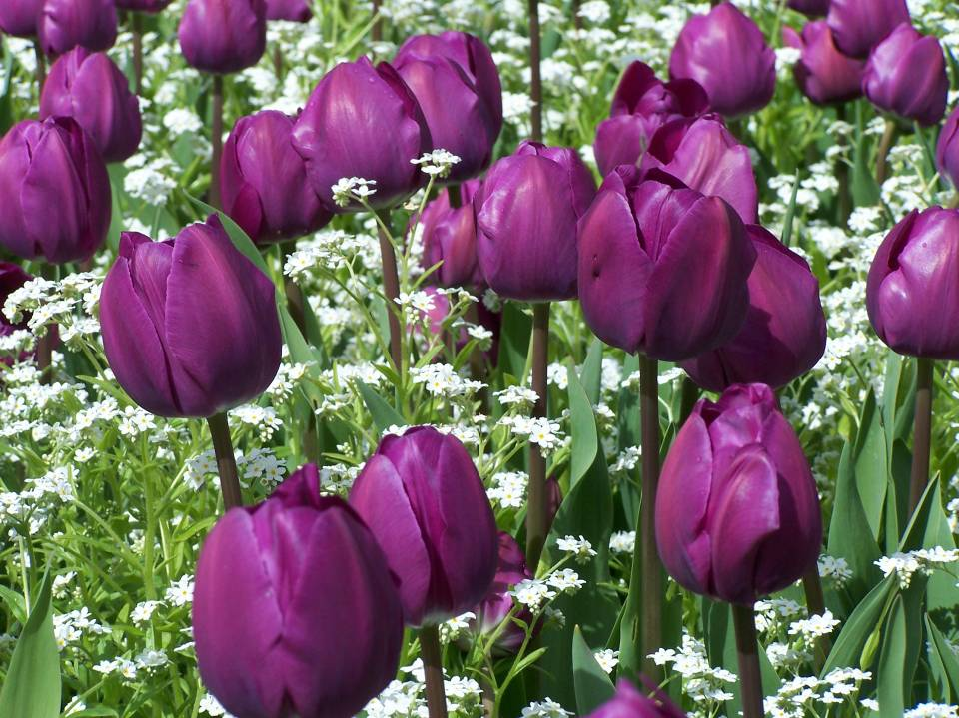
Understanding catalog and tag descriptions
Notes:
Photo: Butchart Gardens (David Whiting)

Slide 72

A good description requires a scientific name
  Plants have many different common names
Positive ID of plant
  Allows more research
423

Slide 73

Plant Description – Complete
Dianthus First Love
  Height: 15-20“ Width: 15“
  Blooms: Spring to fall
  Sun: Sun to partial shade
  Soil Moisture: Moderate watering
  Hardiness: USDA zones 3b-9
  (up to 10,000')
  Culture: Ordinary Garden loam
  Description: A clump-forming dianthus with flowers that change from pure white to deep rose. There is a constant succession of bloom from April to frost. Intensely fragrant with attractive mounds of foliage in winter. Perennial.

Slide 74

Plant Description – Less Complete
Remembrance Columbine
  A hybrid derived from the Colorado state flower.
  The petals and spurs are
  an incredibly rich, shining violet-blue.
  Zones: 3-9
  Height: 14-24"

Slide 75

Plant Description – Rather Incomplete
Moon Carrot
  The basal rosette of succulent, silvery-blue, lacy foliage is substantial. The second year it produces a succession of five inch umbels of pale pink flowers that fade to white. Use as a focal point in the garden.

Slide 76

Let’s examine the terms in more depth…
Notes:
Photo: Fleece Flower (David Whiting)

Slide 77

Catalogs often divide plants into categories based on life cycle or life form
Annuals and tender perennials
Flower bulbs
Perennials
Shrubs and vines
Trees
423
Photo: David Whiting
Notes:
Photo: Government House, Victoria, BC (David Whiting)

Slide 78

Life Cycles
Photo: David Whiting
Notes:
Photo: Danish Flag Poppy and Annual Wheat (David Whiting)

Slide 79

Life Cycles
Annuals
  From seedling to setting seed in a single growing season
  Original plant will not
  come back
  May reseed
423
Notes:
Photo: Impatiens at CSU (David Whiting)

Slide 80

Life Cycles
Reasons to choose annuals
  Longer season of color
  Quick color
  Container gardening
  Cut flowers
  From seed: most
  inexpensive color
  Restyle and re-theme
  the garden every year
423
Notes:
Photo: Petunia Planter at Thanksgiving Point Botanic Gardens (David Whiting)

Slide 81

Life Cycles
Biennials
  Complete life cycle in
  two growing seasons
    Usually have a leaf rosette the first season
    Flower and develop seeds the second summer
  Will not come back a third year
  May reseed
423

Slide 82

Life Cycles
Reasons for using biennials
  Larger, more robust than annuals – some are architectural
  Provide color and form while waiting until
  perennials fill in
423

Slide 83

Life Cycles
Perennials
  Come back for several growing seasons
  Regenerate from roots in addition to seeds
  Some plants are described as either being biennials or short-lived perennials
424

Slide 84

Life Cycles
Reasons to choose perennials
  Invest money once for years of return
  Add structure to garden
  Can provide more of
  a “sense of place”
424
Notes:
Photo: Daylily (David Whiting)

Slide 85


Life Cycles
Bulbs, corms and tubers
  Perennial in native climate
  In Colorado, some require fall
  digging and winter storage
  indoors
424

Slide 87

Exposure
Sun / Shade Requirements
424
Photo: David Whiting
Notes:
Photo: Hamilton Lake Gardens (David Whiting)

Slide 88

Exposure
Full Sun
  Colorado: at least 6 hours
  Other climates: 8-12 hours
424
Notes:
Photo: Sunflower (David Whiting)

Slide 89

Exposure
Part Shade / Part Sun
  Terms used interchangeably
  4-6 hours of sun with dappled shade from trees
  Approximately 4 hours of sun with afternoon shade
    Some catalogs say 6-8 hours
  Afternoon sun more
  similar to full sun
424
Photo: Irene Shonle

Slide 90

Exposure
Light Shade
  Bright, indirect light
  The north side of a
  short building or small
  tree with lighter foliage
Photo: Irene Shonle
424

Slide 91

Exposure
Medium Shade
  Under deciduous trees
    -Unless tree is large and dense
424
Notes:
Photo: Astilbe (David Whiting)

Slide 92

Exposure
Full Shade
  Very dense and dark
  Under evergreens or
  north side buildings
  Dry vs. moist shade
    Different challenges
    Different palettes
424

Slide 94

Irrigation Requirements
424
Photo: David Whiting
Notes:
Photo: David Whiting Garden (David Whiting)

Slide 95
Hydrozones
Routine irrigation
  Watered 1-2 times / week
Reduced irrigation
  Watered 2-4 times / month
  (once plants are established)
Limited irrigation
  Watered during dry spells
Non-irrigated
limited irrigation
reduced irrigation
routine irrigation
patio
424

Slide 96


Colorado’s semi-arid climate
On sites where landscape irrigation is not desirable or possible, focus on natural growth.
425
Notes:
Photo: Colorado County Side (David Whiting)

Slide 97


Pawnee Buttes
National Grassland
Notes:
Photo: Pawnee Buttes National Grassland (David Whiting)

Slide 98

Rabbits Ear Pass
Notes:
Photo: Rabbits Ear Pass east of Steamboat Springs (David Whiting)

Slide 99


Rabbits Ear Pass
Notes:
Photos: Rabbits Ear Pass east of Steamboat Springs (David Whiting)

Slide 100

Gardens with limited to no irrigation
will thrive some years and decline other years
425
Notes:
Photo: Colorado Springs Xeric Demo Garden (David Whiting)

Slide 101

Even xeric plants need rain and/or irrigation during establishment
425
Notes:
Photo: Naturalized golf course (David Whiting)

Slide 102

Drought Tolerance
Notes:
Photo: Colorado Springs Xeric Demo Garden (David Whiting)

Slide 103

Drought tolerance
Symbols indicating water needs
Refer to the catalogue or plant tag key for interpretation.
If no mention and the
catalogue is not from
the West, assume it
can not tolerate
extremely dry soils.
425

Slide 104

Drought Tolerance
Consider where the information is coming from.
  New Mexico?
  Connecticut?
425
Photo: WFF

Slide 105

Drought Tolerance
Hard to interpret
  “Thick roots drive down deeply, making them drought tolerant; struggles in the desert Southwest.”
425
Notes:
Photo: Iris (David Whiting)

Slide 106

Drought Tolerance
Hard to interpret
  If a catalog says nothing about moisture, assume it needs moderate moisture.
    But what is moderate?
425
Photo: David Whiting
Notes:
Photo: David Whiting Garden (David Whiting)

Slide 107
Drought Tolerance
Hard to interpret
  A plant considered to be “xeric”…
    Requires no supplement irrigation
    Needing up to 1” of
    irrigation per week
425
Notes:
Photo: David Whiting Garden (David Whiting)

Slide 108

Drought Tolerance
Characteristics of xeric plants
  Deep taproots
  Leaf adaptations
    Thick
    Waxy
    Fleshy
    Hairy
    Light-colored
    Small and narrow
Photo: Larry Vickerman
425

Slide 109

Xeriscaping is NOT a rock pile.
Notes:
Photo: Fort Collins area home (David Whiting)

Slide 111

Soil Requirements
425
Photo: David Whiting
Notes:
Title Slide

Slide 112

Soil Requirements
Beware of “woodsy or woodland” soils
  Usually means high in humus and acidic
    Only a few places in Colorado have similar soils
425

Slide 113


Soil Requirements
Catalogs often refer to “ordinary soil”
  What is “ordinary”?
425

Slide 114

Soil Requirements
Sweet soils = alkaline = pH > 7.0
  Colorado soils are generally alkaline.
    Acid loving plants usually not a good choice for Colorado.
425

Slide 115


Soil Requirements
On clay soils watch out for:
“Needs well drained soil”
425

Slide 116

Soil Requirements
Hard to interpret
  “Dry soil”
    “Needs well-drained, even dry soil;
    struggles in desert Southwest”
425

Slide 118

Bloom Period
Photo: David Whiting
Notes:
Photo: Begonias and ferns at Butchart Botanic Gardens (David Whiting)

Slide 119

Bloom Period
Consider when you want your plants to bloom
  Does your garden bloom
  only in the spring?
426

Slide 120


Bloom Period
summer
Choose plants that bloom over different seasons
  Spring
  Late spring
  Early summer
  Summer
  Late summer
  Fall
spring
426

Slide 121

Bloom Period
summer
Short growing season
  Avoid late bloomers
426

Slide 122

Bloom Period
summer
Length of bloom
  Perennials bloom for one - six weeks or even longer
    Do you want a changing palette of plants, or
    fewer longer-blooming plants?
    Keep garden size in mind
426
Notes:
122
Photo: Private Garden (David Whiting)

Slide 124

Mature Height and Width
Photo: David Whiting
Notes:
Photo: Butchart Botanic Gardens (David Whiting)

Slide 125

Mature Height and Width
Consider overall size of mature plant
426
Photo: Kerrie Badertscher

Slide 126


Mature Height and Spread
It is easy to plant too closely, especially with smaller sized pots.
Do you have room between plants?

Slide 127

Mature Height and Spread
How tall will it get?
  Is this a better plant for the front or back of the border?
426
Photo: Kerrie Badertscher

Slide 128


Mature Height and Spread
Growth Form
  Clumping
    Individual plants form clumps rather than spreading evenly to fill bed
    Choose these for mixed border
Photo: Irene Shonle
427

Slide 129

Mature Height and Spread
Growth Form
  Upright
    Taller than wide
    Choose when space is premium
427

Slide 130


Mature Height and Spread
Growth Form
  Trailing or creeping
    Groundcover to fill in bed
    Hang over wall
    Hanging baskets
Photo: Irene Shonle
427

Slide 132

Worksheet Activity
CMG GardenNotes #512
Herbaceous Plants,
Right Plant, Right Place
Notes:
Point students to worksheet

Slide 133
Break Time
10 minutes remaining
Notes:
Break timer – set to auto-advance in 1 minutes
HOWEVER, check that it is working on the computer being used.
Line drawing: Microsoft clipart

Slide 134
Break Time
9 minutes remaining
Notes:
Break timer – set to auto-advance in 1 minutes
HOWEVER, check that it is working on the computer being used.
Line drawing: Microsoft clipart

Slide 135
Break Time
8 minutes remaining
Notes:
Break timer – set to auto-advance in 1 minutes
HOWEVER, check that it is working on the computer being used.
Line drawing: Microsoft clipart

Slide 136
Break Time
7 minutes remaining
Notes:
Break timer – set to auto-advance in 1 minutes
HOWEVER, check that it is working on the computer being used.
Line drawing: Microsoft clipart

Slide 137
Break Time
6 minutes remaining
Notes:
Break timer – set to auto-advance in 1 minutes
HOWEVER, check that it is working on the computer being used.
Line drawing: Microsoft clipart

Slide 138
Break Time
5 minutes remaining
Notes:
Break timer – set to auto-advance in 1 minutes
HOWEVER, check that it is working on the computer being used.
Line drawing: Microsoft clipart

Slide 139
Break Time
4 minutes remaining
Notes:
Break timer – set to auto-advance in 1 minutes
HOWEVER, check that it is working on the computer being used.
Line drawing: Microsoft clipart

Slide 140
Break Time
3 minutes remaining
Notes:
Break timer – set to auto-advance in 1 minutes
HOWEVER, check that it is working on the computer being used.
Line drawing: Microsoft clipart

Slide 141
Break Time
2 minutes remaining
Notes:
Break timer – set to auto-advance in 1 minutes
HOWEVER, check that it is working on the computer being used.
Line drawing: Microsoft clipart

Slide 142
Break Time
1 minute remaining
Notes:
Break timer – set to auto-advance in 1 minutes
HOWEVER, check that it is working on the computer being used.
Line drawing: Microsoft clipart

Slide 143
Please take your seats, ready to continue class

Slide 144

Other considerations
  Fragrance
  Wildlife
  Insect and disease resistance
  Hail resistance
  Staking
  Division
  Attractive Foliage
427
Photo: David Whiting
Notes:
Photo: Butchart Botanic Gardens (David Whiting)

Slide 145

Fragrance
Place near
  Paths
  Patios
  Windows
  Doors
427
Photo: Kerrie Badertscher

Slide 146


Fragrance
Only listed as fragrant if they are.
    Will not mention fragrance otherwise
  Not all cultivars within
  a species are fragrant.
427

Slide 147

Wildlife Resistance
Look for symbols in catalogs
  Does not mean wildlife PROOF
    Plant susceptibility varies with location
427

Slide 148

Wildlife Resistant Plants
Very aromatic plants
Prickles and spines
Tough, leathery leaves
Toxic plants
Milky sap
427

Slide 149

Insect and Disease Resistance
  Resistant species and cultivars make good choices
427

Slide 150


Insect and Disease Resistance
May only pick up on a problem if you read through description of all the cultivars.
  Description of Monarda (Bee Balm) says nothing of it being susceptible to powdery mildew, nor do two of the cultivar descriptions.
  However “Red Shades” is
  listed as “very resistant
  to powdery mildew.”
427
Notes:
150

Slide 151

Hail
  Big or soft leaved plants such as Hostas are very vulnerable to hail.
  Narrow and
  tougher leaved
  plants are more
  resilient.
428
Notes:
Photo: Hosta and Fern (David Whiting)

Slide 152

Need for Staking
Top-heavy and tall plants often need staking.
In a windy location, consider looking for shorter cultivars.
  “Never Needs Staking”
  “The choice for small gardens”
428

Slide 153


Need for Division
Some plants need to be divided more frequently than others
428
Photo: David Whiting

Slide 154

Need for Division
Need for frequent division
  “High maintenance”
  Good sources of plants to share
428

Slide 155
Need for Division
Information on dividing
  Rarely be found in catalogs
  Must be looked up in other reference materials
428

Slide 156




Attractive or Contrasting Foliage
Consider how the plant will look out of bloom; will the foliage still look attractive?
Consider the range of colors, sizes, and shapes of leaves.
Do the leaves have good
fall color?
Photo: Irene Shonle
428
Photo: Irene Shonle

Slide 157

Attractive or Contrasting Foliage
Plants for foliage is a new design trend.
428
Notes:
Photo: Ferns and Hosta (David Whiting)

Slide 158

Notice how the foliage sets off the flowers
Photo: David Whiting
Notes:
Photo: Butchart Botanic Gardens (David Whiting)

Slide 160
Small Group Discussion
Talk about times when you made a mistake in choosing a plant – too tall, was eaten by deer, etc.
  What did you learn from it, and how would you choose differently?

Slide 161

Best New Cultivars
511-12
Notes:
Photo: CSU Trial Gardens (David Whiting)

Slide 162

Programs that seek out the best new varieties
CSU Trial Gardens
  Annual trial gardens
  PERC trial gardens
  All America Selection
PlantSelect®
428
Notes:
Photo: CSU Trial Gardens (David Whiting)

Slide 164

Ecological Adaptation
429
Notes:
Photo: Oxide Daisy in Fort Collins Natural Area (David Whiting)

Slide 165

Ecological Adaptation
Goal: “right plant in the right place”
Characteristics of the ideal Colorado perennial
  Prefer soil conditions similar to what we have
  Low irrigation requirement
  Hardy
  Long-lived
  Self-seed before dying
429
Notes:
Photo: Columbine (David Whiting)

Slide 166

Ecological Adaptation
Can a plant be too well-adapted?
Some plants can do too well
Can be noxious weeds, escaping from gardens and taking over native vegetation
Hesperis matronalis
Dames Rocket
429

Slide 167

Ecological Adaptation
Let’s evaluate a plant
Sulfur flower
Eriogonum umbellatum
Native perennial
Grows in clayey or sandy soils, plains or mountains
Wildlife resistant
Drought tolerant
Full sun
Self seeds
Notes:
167

Slide 168

Ecological Adaptation
Let’s evaluate another plant
Myrtle spurge
Euphorbia myrsinites
Very xeric
Attractive blue-green leaves
Grows well in a variety of soils
Great ground cover
Spreads readily
Very wildlife resistant
Notes:
Photo: Myrtle spurge (Co. Dept o Agriculture)

Slide 169
Ecological Adaptation
Let’s evaluate this plant again
Myrtle spurge
Euphorbia myrsinites
Very xeric
Attractive blue-green leaves
Grows well in a variety of soils
Great ground cover
Spreads readily
Very wildlife resistant
Was once widely planted in Colorado
Now on Colorado Noxious Weed List A
Notes:
169
Photo: Myrtle Spurge (Co Dept. of Agriculture)

Slide 170

Ecological Adaptation
Clues to overly well-adapted plants
“Quickly spreads to give blanket of color”
“Naturalizes readily”
429
Notes:
Picture: California Poppy (Jim Klett)

Slide 171

Ecological Adaptation
Clues to overly well-adapted plants
“Resist the temptation to crowd plants too closely--they will spread of their own accord soon enough”
“Vigorous spreader, but that's no vice with
looks like these”
429
Notes:
Picture: Texas Evening Primrose (Texas A&M University)

Slide 172

Ecological Adaptation
Clues to overly well-adapted plants
“Plants are typically short-lived but they seed themselves quite freely, so you’ll always have plenty around”
“Give this plant lots of room”
429

Slide 173

Ecological Adaptation
Aggressive
  Can take over your yard
  Might escape into wild
429

Slide 174

Ecological Adaptation
Invasive
  Loosely used
  Generally: plants that escape into wild situations
  Sometimes used interchangeably with aggressive
429

Slide 175


Ecological Adaptation
Native
  Naturally grows in Colorado
Alien
  Not native to this country
  Not native to Colorado
429
Notes:
Photo: Colorado Columbine at Rabbits Ear Pass (David Whiting)

Slide 176

Colorado Noxious Weeds
covered in another class
  Defined by state law
  Always an alien
  Illegal to sell or grow in Colorado
429

Slide 177

Plants behave differently in different climates
Not all plants are aggressive in all climates
  What is aggressive on the East Coast may not
  be aggressive here, and vice versa
Kudzu in Florida
--not a problem here!
429
Photo:grandpacliff.com

Slide 179

Homework
CMG GardenNotes #514

