Slide 1

Notes:
Title slide

Slide 2
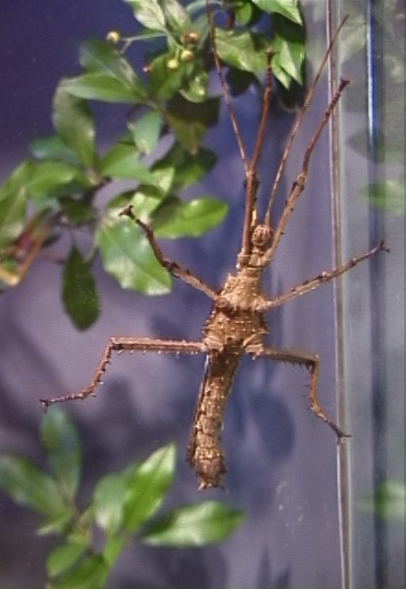
Insect ID
Colorado Master Gardener^{sm} Program
Colorado Gardener Certificate Training
Colorado State University Extension
Copyright 2012. Colorado Master Gardener Program,
Colorado State University Cooperative Extension.
All Rights Reserved.
Line drawing from U.S.D.A.
Notes:
Title Slide

Slide 3
Please hold questions for
Question Pause.
Ask questions clarifying points of discussion.
Notes:
3
Remind students
To hold questions to the question pause slide.
Questions asked during class time must be directly related to points of discussion.
Line drawing: Microsoft clipart

Slide 4

The Science of Gardening
Chapter 22, page 219
Identifying Insects
CMG GardenNotes #311-315

Slide 5
Page number
in textbook
219

Slide 6
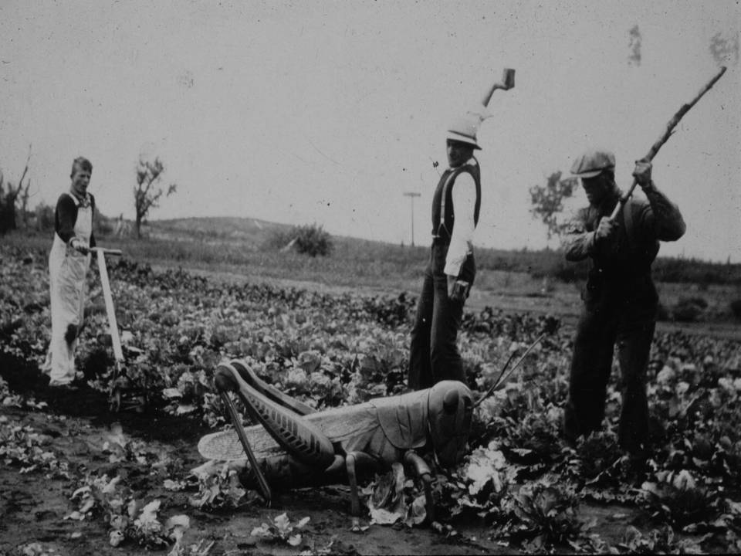
Need to correctly ID the insect before management can be addressed.

Slide 7
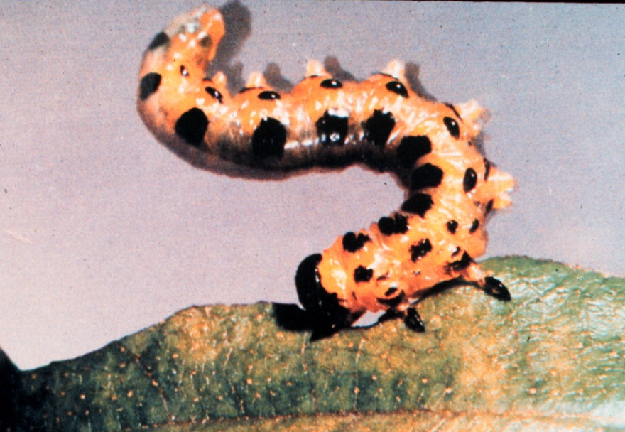
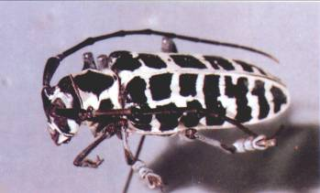
Need to correctly ID the insect before management can be addressed.
Identify by type of damage on host
  Leaf feeding
  Leaf sucking
  Borers
Identify to Orders
  Coleoptera (beetles)
  Diptera (flies)
  Hemiptera (true bugs)

Slide 8
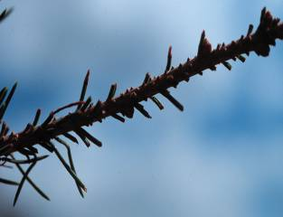
Diagnosing Insect Problems
Easy
  Insect present
  Large enough to examine
  Associated with injury
More Difficult
  Tiny, can’t be visually examined easily
  Insect damage without insect
  Insect not associated with plant damage
220

Slide 9
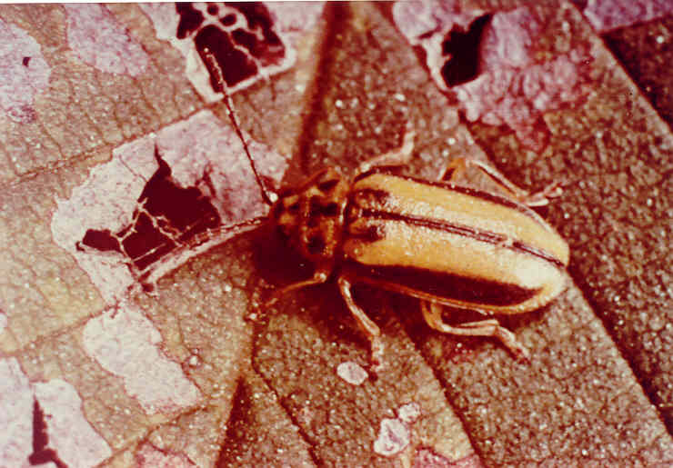
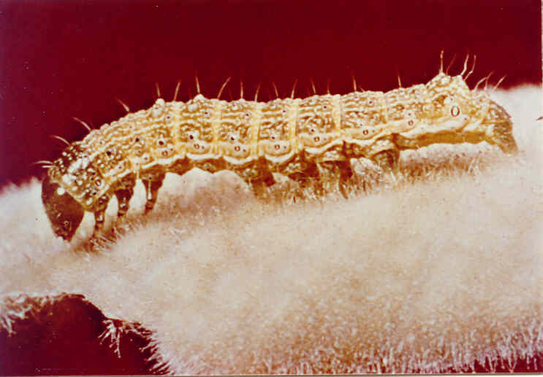
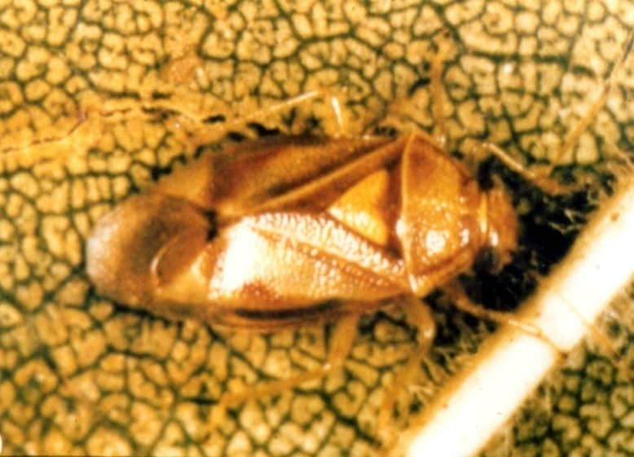
Identifying Insects to Taxonomic Orders
Coleoptera -- Beetle
Lepidoptera -- Caterpillar
220
Hemiptera – Plant Bug

Slide 10

Arthropods
Phylum: Arthropoda
  Chitinous exoskeleton
  Segmented body
  Jointed appendages
Microsoft clipart
220

Slide 11
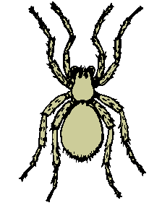
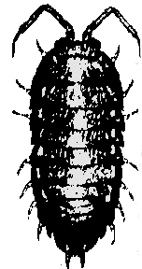

Arthropods
Phylum = Arthropoda
Class
  Arachnida – spiders, mites, ticks,
  scorpions, daddy-long-legs
  Chilopoda – centipedes
  Crustacea – lobster, crabs, shrimp, sowbugs
  and pillbugs
  Diplopoda – millipedes
  Hexapoda or Insecta – insects
  Symphyla – garden centipedes
  Etc.
220 & 221

Slide 12
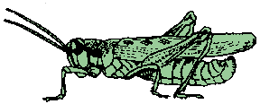
Arthropods
Phylum = Arthropoda
Class = Hexapoda (Insecta)
  Order
    Coleoptera – beetles
    Diptera – flies
    Lepidoptera – butterflies & moths
    Hemiptera – true bugs
    Hymenoptera – ants, bees, hornets, wasps
    Etc.
220

Slide 13
Arthropods
Phylum = Arthropoda
Class = Hexapoda or Insecta
  Order
    Family
      Genus and species
220

Slide 14
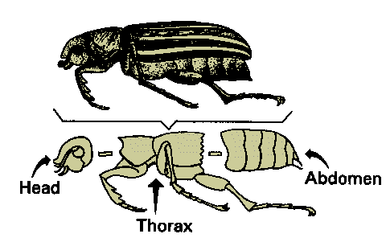
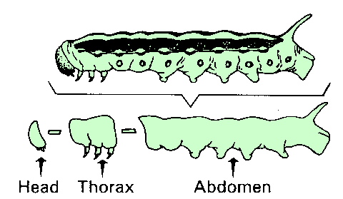
Three body regions
  Head
  Thorax
  Abdomen
222

Slide 15
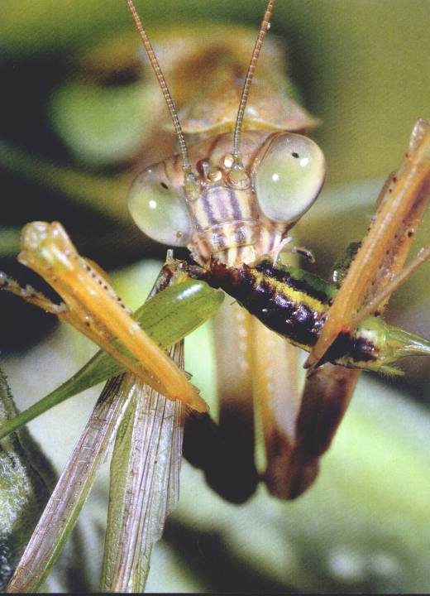
Head
Antennae
Eyes
Mouthparts
222

Slide 16
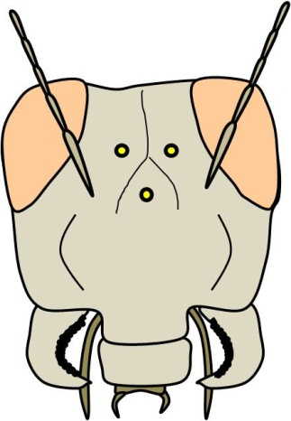
Head
Eyes
  Compound Eyes
    Multiple cornea
      Dragonfly: 50,000
      House fly: 4,000
  Ocelli – light responsiveness
    Adults: 2-3
    Immatures: 1-8
222

Slide 17
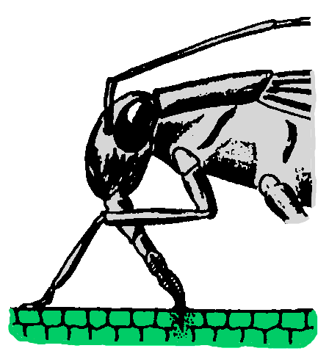
Head
Mouthparts
  Chewing Piercing-sucking
222

Slide 18
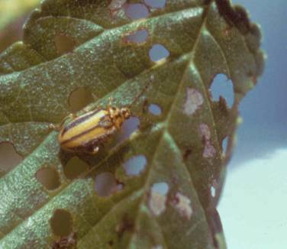
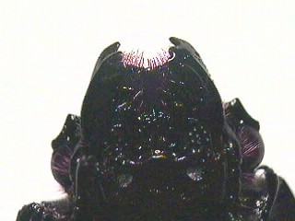
Head
Mouthparts – Feeding Damage
  Chewing
223
Notes:
Left: photograph of beetle mouthparts
Right: Insects with feeding mouthparts consume what they are feeding on.

Slide 19
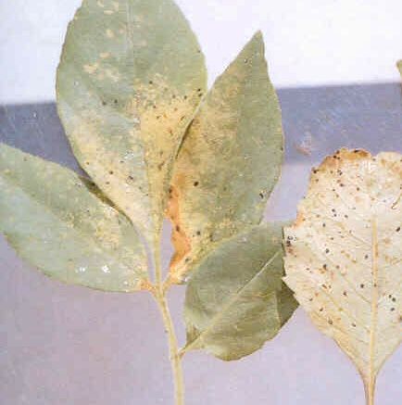
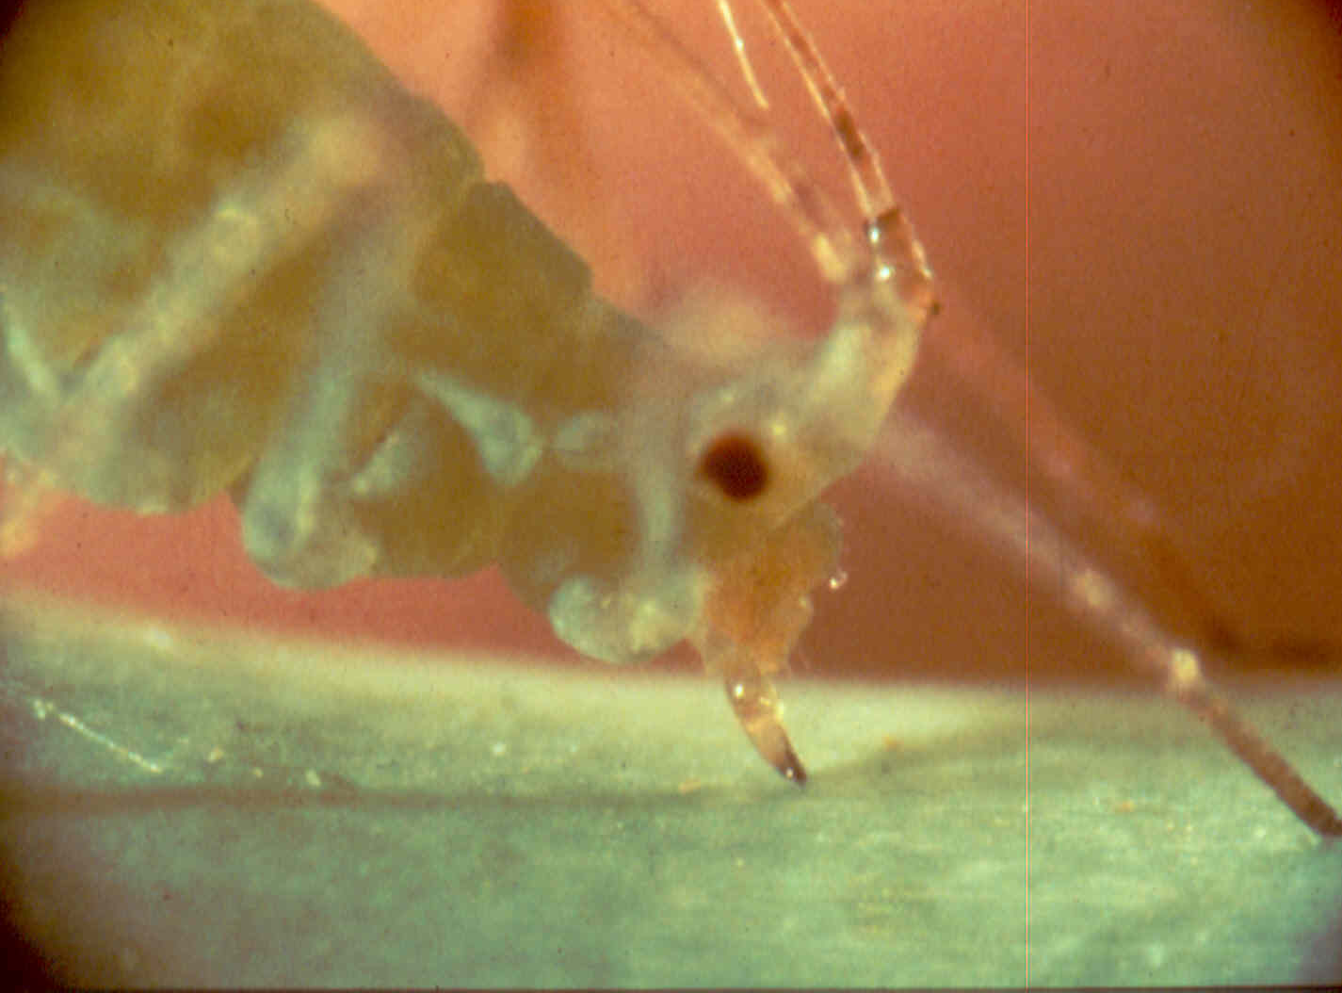
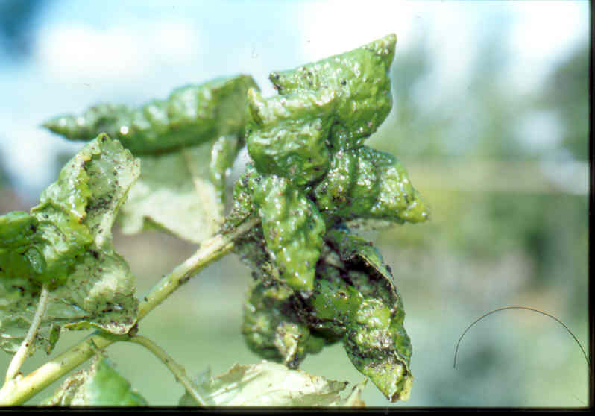
Head
Mouthparts – Feeding Damage
  Piercing-sucking
223
Notes:
Left: feeding aphid
Center: Curled leaves is a symptom of piercing-sucking insects. Uncurl the leave and look for insects or insect body parts.
Right: Insects with piercing sucking mouthparts inject a saliva-like substance as the begin to feed. It may be phytotoxic to the cells and cause spotting or curling.

Slide 20
Head
Mouthparts
  Chewing Piercing-sucking
222

Slide 21
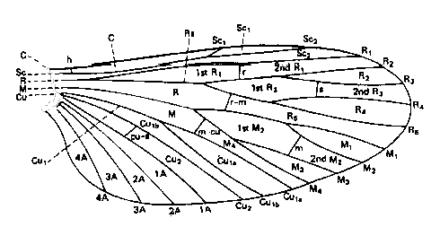
Thorax
Wings
  Key feature in insect identification
    2 (1 pair) or 4 (2 pair) on adults
    Texture
    Size and shape
    Vein pattern
224

Slide 22
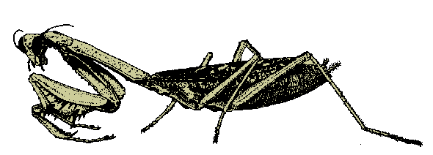
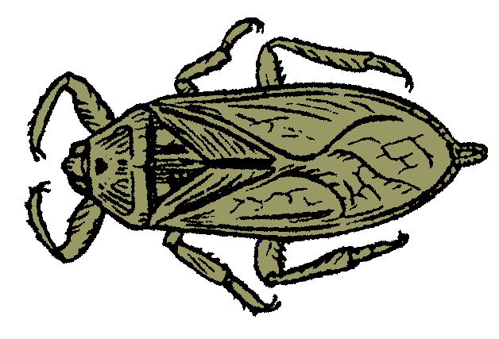
Thorax
Legs
  3 pair
  Modified for special activity, like running or jumping.
224

Slide 23
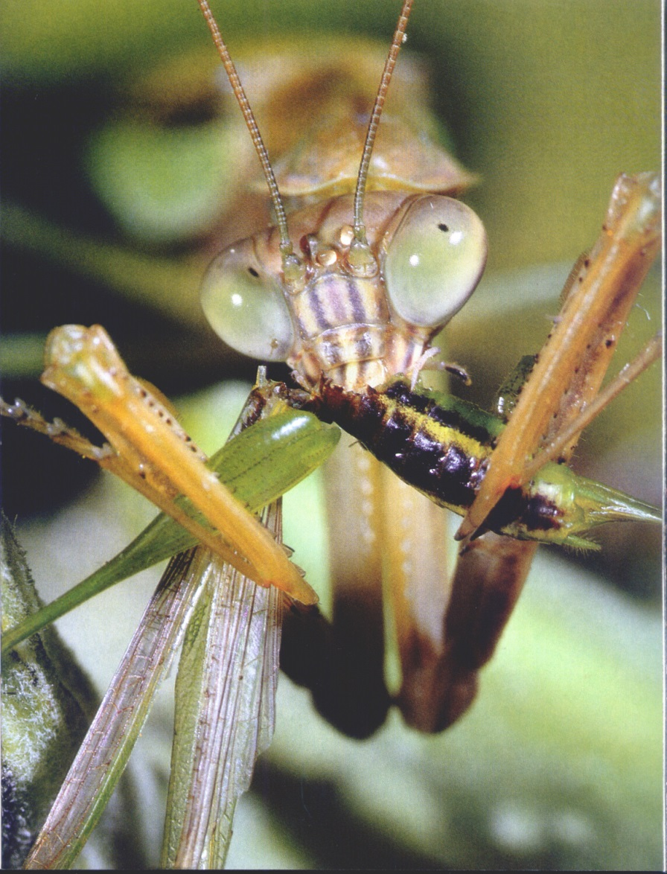
Thorax
Legs
  Modified for capturing and holding prey
224

Slide 24
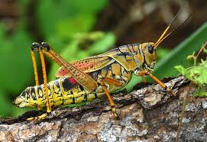
Thorax
Legs
  Modified for jumping
224

Slide 25
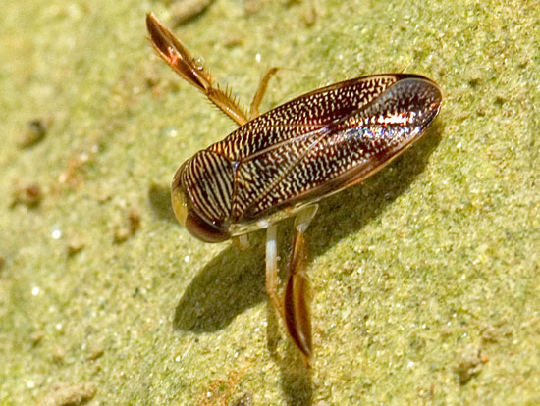
Thorax
Legs
  Modified for swimming
224

Slide 26
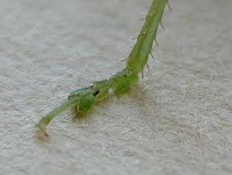
Thorax
Legs
  Legs and feet (tarsi)
  used in insect identification
224

Slide 27
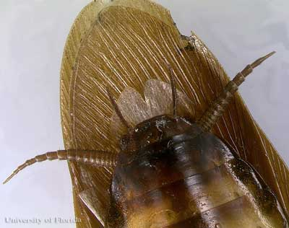
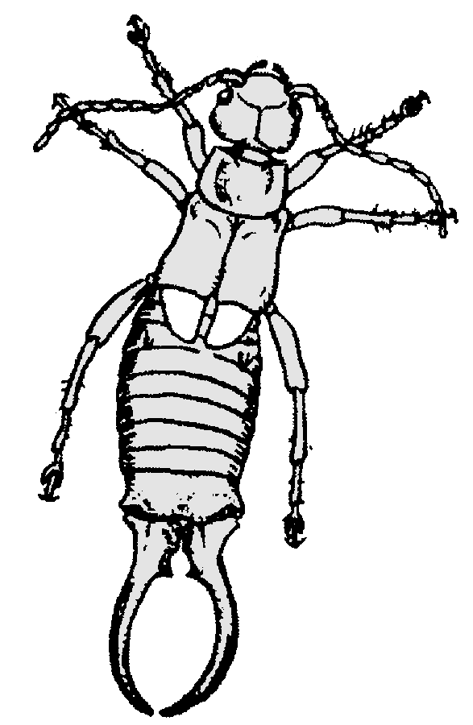
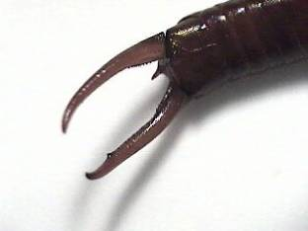
Abdomen
Cerci
225

Slide 28
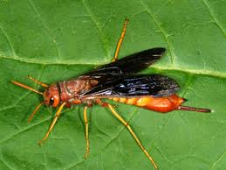
Abdomen
Ovipositor
225

Slide 29
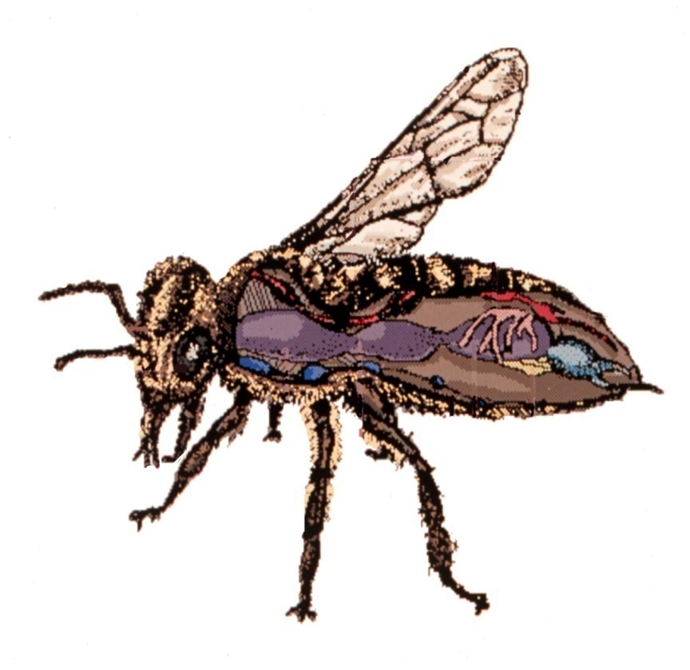
Insect Internal Physiology
Muscles
  Very small, strong and often capable of extremely rapid movement.
    Grasshoppers: >900 muscles
    Caterpillars: >4000 muscles
225
Microsoft drawing

Slide 30

Insect Internal Physiology
Circulatory system
  Open type; heart pumps blood toward head, bathing the organs in the body cavity
225
Microsoft drawing

Slide 31

Insect Internal Physiology
Respiratory system
  Oxygen and carbon dioxide move by diffusion through slender branching tubes or tracheae.
225
Microsoft drawing

Slide 32

Insect Internal Physiology
Reproductive system
  Most insect reproduction is sexual (union of egg cell from female with sperm cell from male).
  Parthenogenesis: production of young without fertilization.
225
Microsoft drawing

Slide 33
What questions do you have about the insect anatomy?
Notes:
Check for questions

Slide 34
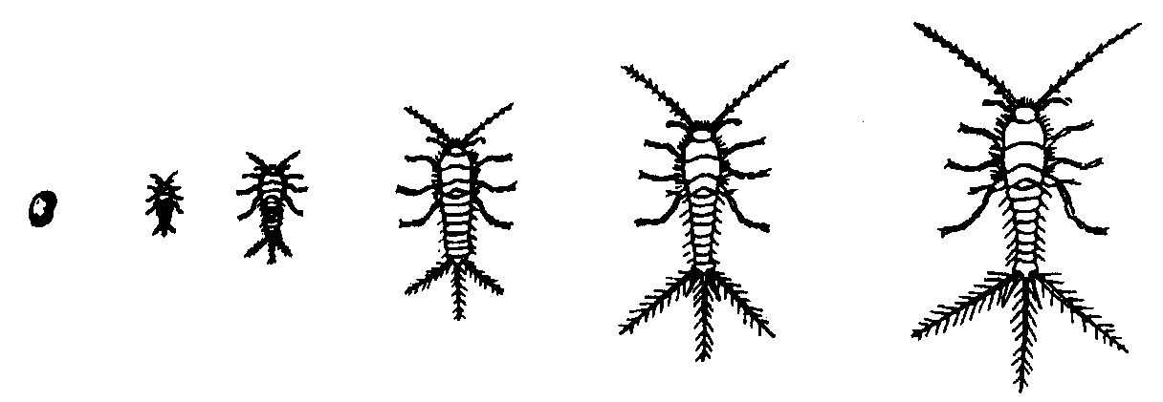
No Metamorphosis
  Egg Nymphs Adult
Examples
Thysanura (silverfish)
Collembola (springtails)
226

Slide 35
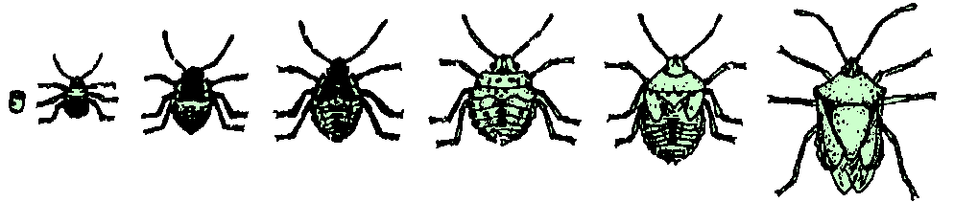
Simple Metamorphosis
Gradual Metamorphosis
  Egg Nymphs Adult
Examples
Homoptera (aphids, scale)
Hemiptera (true bugs)
Orthoptera (grasshoppers, crickets)
226

Slide 36
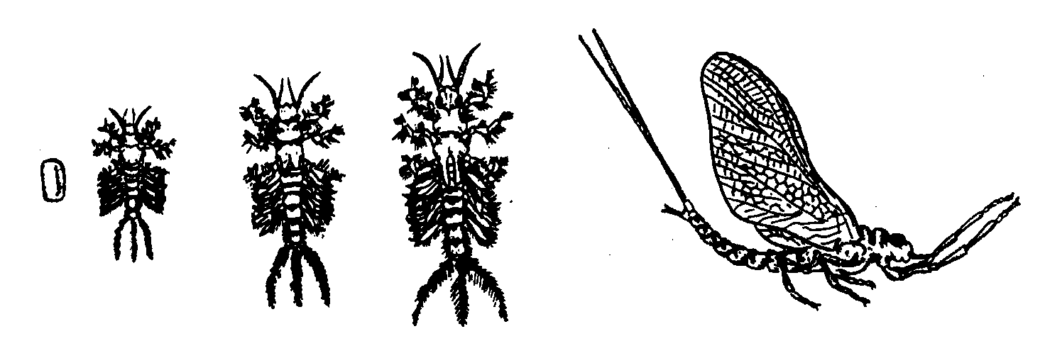

Simple Metamorphosis
Incomplete Metamorphosis
  Egg Niad (aquatic nymphs) Adult
Examples
Ephemeroptera (mayflies)
Odonata (dragonflies)
Plecoptera (stoneflies)
226

Slide 37
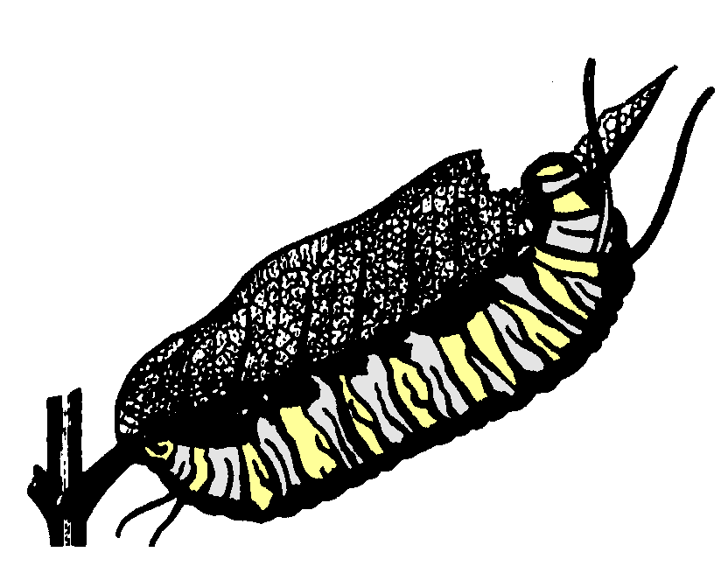

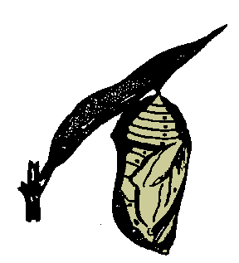
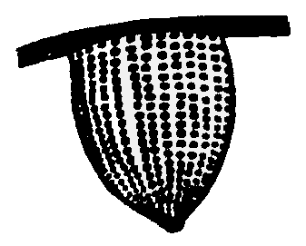
Complete Metamorphosis
egg larvae pupa adult
  Examples
  Lepidoptera (butterflies, moths)
  Coleoptera (beetles)
  Diptera (flies)
  Hymenoptera (bees, wasps, ants)
226

Slide 38
What questions do you have about the metamorphosis?
Notes:
Check for questions

Slide 39
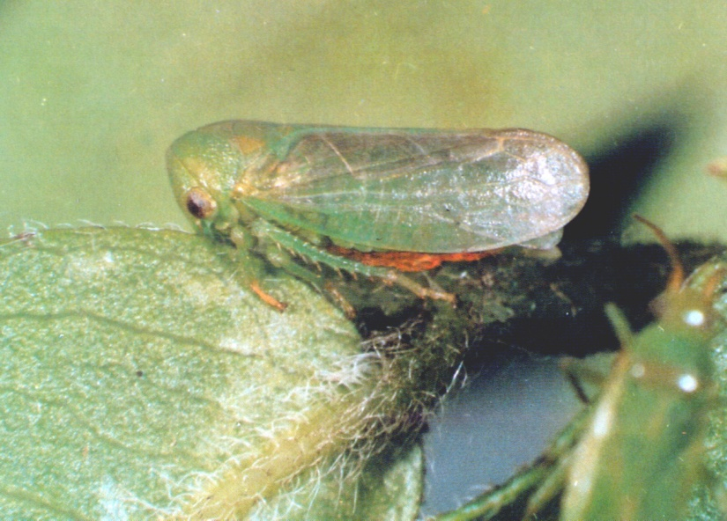
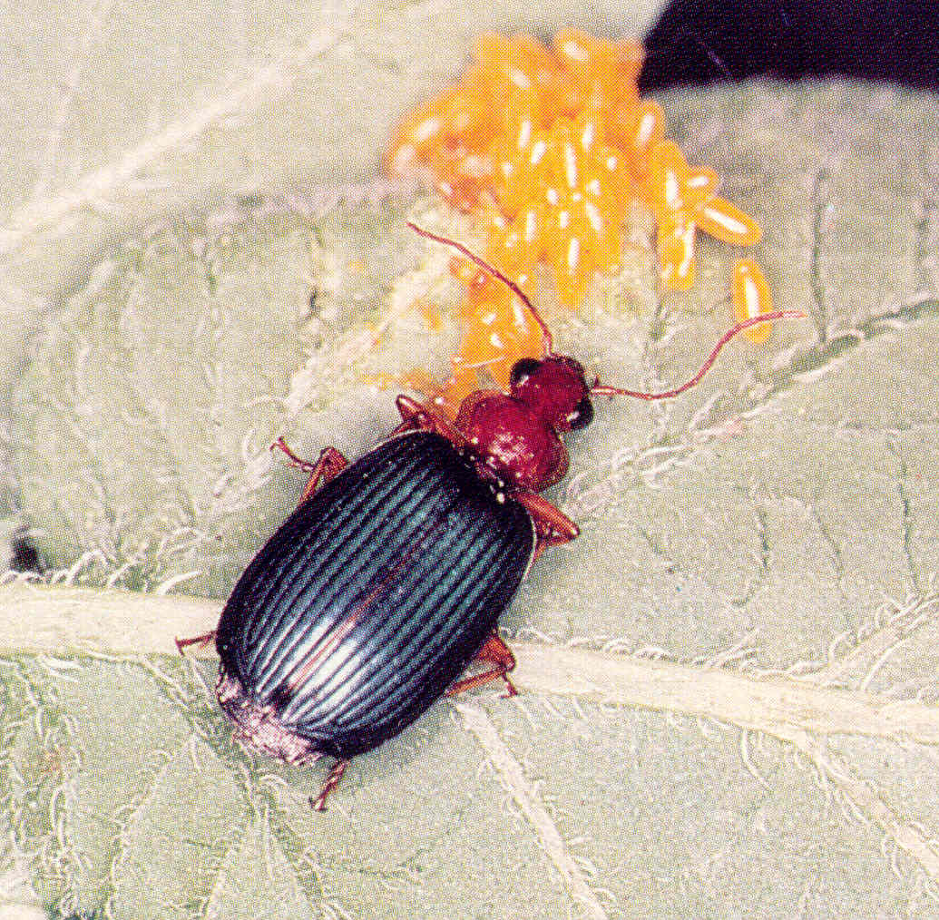
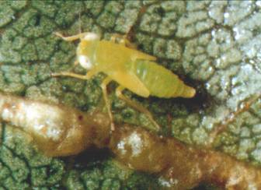
Common
Orders of Insects

Slide 40
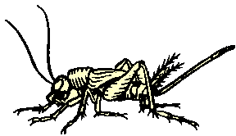
Orthoptera
Crickets, grasshoppers, katydids
Metamorphosis: simple/gradual
Mouthparts: chewing
Legs: hind legs enlarged for jumping
240

Slide 41
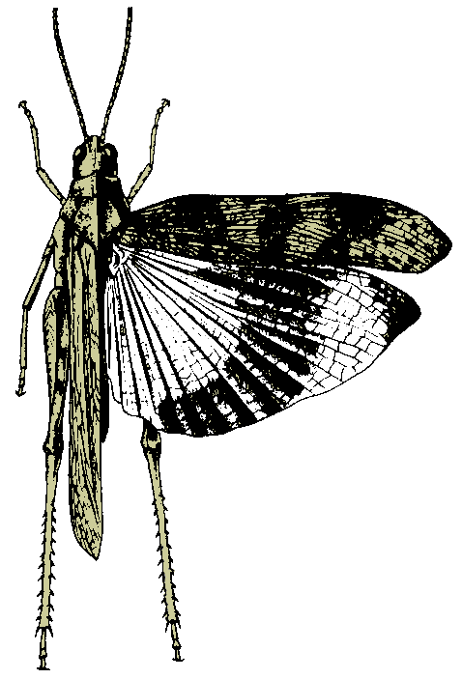
Orthoptera
Crickets, grasshoppers, katydid
Wings: 2 pair
  Front wings more or less parchment-like with distinct venation.
  Hind wings membranous and fold fan-like when at rest.
  Wings may be used for sound.
240

Slide 42
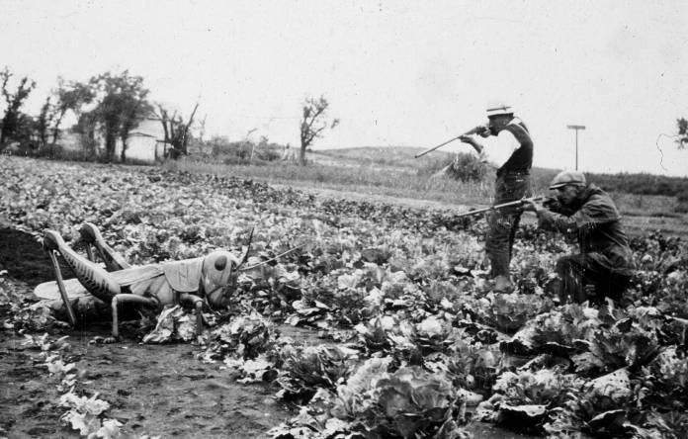
Orthoptera
Crickets, grasshoppers, katydid
240

Slide 43
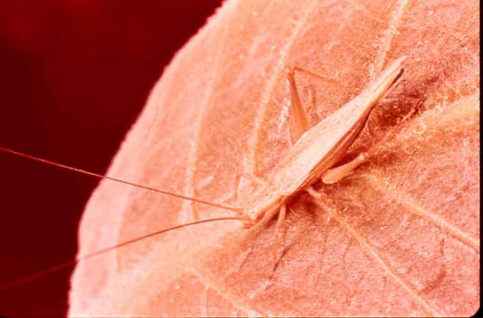
Orthoptera
Crickets, grasshoppers, katydid
Snowy Tree Cricket
240

Slide 44
What questions do you have about
Orthoptera cricketes, grasshoppers and katydids?
Notes:
Check for questions

Slide 45
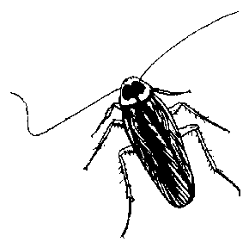
Dictyoptera
Suborder Blattaria
Cockroach, woodroach
Most species are found in warmer subtropical to tropical areas.
The German, Oriental and American cockroach are indoor pests.
Woodroaches live outdoors
on decaying bark, and
other debris.
228

Slide 46
Dictyoptera
Suborder Blattaria
Cockroach, woodroach
Metamorphosis: simple/gradual
Mouthparts: chewing
Wings: thick and lay over
abdomen, if present
Antennae: long, thread-like
Body: flattened
Cerci: forceps-like appendage
on abdomen of most adults
228

Slide 47
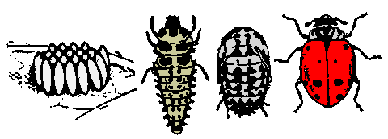
Coleoptera
Beetles, weevils
Metamorphosis: complete
egg grub pupa adult
229

Slide 48
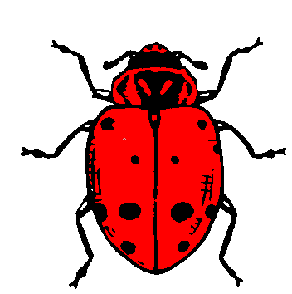
Coleoptera
Beetles, weevils
Adult
Wings: 2 pair
  Front wings: thickened, leathery, shell-like, makes a straight line down back when at rest.
  Hind wings: membranous
Mouthparts: chewing
Antenna: noticeable
Body: generally quite stout
Cerci: none

Slide 49
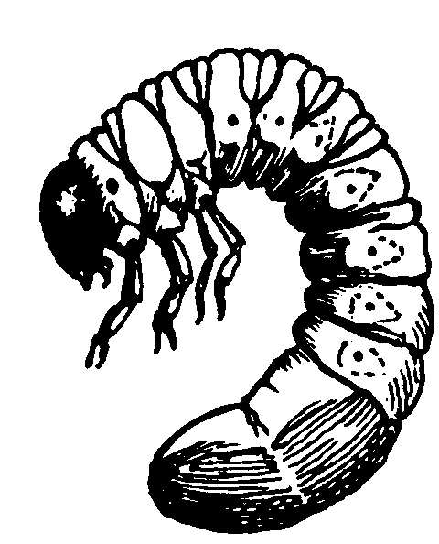
Coleoptera
Beetles, weevils
Larva -- Grub
Head: capsule
Mouthparts: chewing
Legs: 3 pair of legs on thorax,
no legs on abdomen
229

Slide 50

Coleoptera
Beetles
Larva
Exception: Some wood-boring beetle larva are maggot-like
  No head capsule
  No legs
Flat headed borer
229

Slide 51

Coleoptera
Leaf feeding beetles
Elm leaf beetle adult
Elm leaf beetle grub
229

Slide 52



Coleoptera
Shade tree borers
Elm bark beetles gallery
Long-horned beetle
Locust borer
Flat-headed borer larva

Slide 53

Coleoptera
Beneficials -- predators
229

Slide 54


Coleoptera
Beetles, grubs
229

Slide 55
What questions do you have about the
Coleoptera, beetles?
Notes:
Check for questions

Slide 56
Hemiptera
New taxonomy
Hemiptera
  Heteroptera
    True bugs
  Sternohynncha
    Aphids
    Psyllids
    Scales
  Auchenorhynncha
    Leafhoppers
    Planthoppers
Most books
Hemiptera
  True bugs
Homoptera
  Aphids
  Leafhoppers
  Mealybugs
  Psyllids
  Scale
  Whitefly
232

Slide 57
Hemiptera
True bugs: plant bugs, squash bugs, stink bugs
Metamorphosis: simple/gradual
Egg Nymphs Adult
232

Slide 58

Hemiptera
True bugs: plant bugs, squash bugs, stink bugs
Wings: 2 pair
  Front wings: thickened at
  base and membranous at tips
    Overlapping at tips when
    at rest
    Forming triangle plant
    between base of wings
  Hind wing: membranous
Body: usually broad and somewhat flattened

Slide 59

Hemiptera
True bugs: plant bugs, squash bugs, stink bugs
Mouthparts: piercing-sucking
  Jointed beak usually easily visible and appears to arise
  from front of head, ahead
  of eyes.
233

Slide 60


Hemiptera
True bugs: plant bugs, squash bugs, stink bugs
Mouthparts: piercing-sucking
233

Slide 61



Hemiptera
True bugs: plant bugs, squash bugs, stink bugs
Ash plant bugs and damage
233

Slide 62


Hemiptera
Many of the Hemiptera are beneficials.
233

Slide 63


Hemiptera
True bugs: plant bugs, squash bugs, stink bugs
Boxelder bug nymph and adult
233

Slide 64
What questions do you have about the
Hemiptera, true bugs?
Notes:
Check for questions

Slide 65



Hemiptera / Homoptera
Aphids, cicadas, leafhoppers, mealybugs, scale, whiteflies, etc.
Aphid
Leafhopper
Scale
234

Slide 66


Hemiptera / Homoptera
Aphids, cicadas, leafhoppers, mealybugs, scale, whiteflies
Mouthparts: piercing-sucking
  Jointed beak not highly visible and appears to arise from area between front legs.
  Excretion of
  honeydew
  common
234

Slide 67

Hemiptera / Homoptera
Aphids, cicadas, leafhoppers, mealybugs, scale, whiteflies
Mouthparts: piercing-sucking
  Jointed beak not highly visible and appears to arise from area between front legs
234

Slide 68

Hemiptera / Homoptera
Aphids, cicadas, leafhoppers, mealybugs, scale, whiteflies
Metamorphosis: simple/gradual
Wings: 2 pair; membranous
  Generally held roof-like over body at rest
  Many wingless forms in order
234

Slide 69



Hemiptera / Homoptera
Aphids
234

Slide 70


Hemiptera / Homoptera
Aphids
234

Slide 71


Hemiptera / Homoptera
Aphids
234

Slide 72


Hemiptera / Homoptera
Wooly aphids

Slide 73


Hemiptera / Homoptera
Leafhoppers…
Leafhopper
234

Slide 74



Hemiptera / Homoptera
Leafhoppers…
Treehopper
Leafhopper
Buffalohopper
234

Slide 75


Hemiptera / Homoptera
Mealybugs
Mealybugs on Honeylocust trunk
234

Slide 76

Hemiptera / Homoptera
Psyllids
234

Slide 77



Hemiptera / Homoptera
Scale
Black Pine Needle Scale
Oyster Shell Scale
Spruce
Bud Scale
234

Slide 78

Hemiptera / Homoptera
Spittlebugs
234

Slide 79


Hemiptera / Homoptera
Whiteflies
234

Slide 80

Hemiptera / Homoptera
Aphids, cicadas, leafhoppers, mealybugs, scale, whiteflies, etc.
Aphid
Leafhopper
Scale
234

Slide 81
What questions do you have about the
Homoptera?
Notes:
Check for questions

Slide 82
Participation question
What order is this insect?
  Othroptera (crickets, grasshoppers)
  Coleoptera (beetles)
  Hemiptera (true bugs)
  Homoptera (aphids)

Slide 83
Participation question
What order is this insect?
  Othroptera (crickets, grasshoppers)
  Coleoptera (beetles)
  Hemiptera (true bugs)
  Homoptera (aphids)

Slide 84

Participation question
What order is this insect with thickened, shell-like wings?
  Othroptera (crickets, grasshoppers)
  Coleoptera (beetles)
  Hemiptera (true bugs)
  Homoptera (aphids)

Slide 85
Participation question
What order is this insect with thickened, shell-like wings?
  Othroptera (crickets, grasshoppers)
  Coleoptera (beetles)
  Hemiptera (true bugs)
  Homoptera (aphids +)

Slide 86

Participation question
What order is this insect?
  Othroptera (crickets, grasshoppers)
  Coleoptera (beetles)
  Hemiptera (true bugs)
  Homoptera (aphids, leafhoppers)

Slide 87
Participation question
What order is this insect?
  Othroptera (crickets, grasshoppers)
  Coleoptera (beetles)
  Hemiptera (true bugs)
  Homoptera (aphids, leafhoppers)

Slide 88

Lepidoptera
Butterflies, moths
Metamorphosis: complete
Egg Larva: Caterpillar Pupa Adult
237

Slide 89


Lepidoptera
Butterflies, moths
Adults -- butterflies, moths
Wings: 2 pair; covered with
small overlapping scales,
often but not always
highly colored
Mouthparts: coiled
sucking tube
Some species don’t feed.
237

Slide 90
Lepidoptera
Butterflies, moths
Larva -- caterpillar
Legs:
  3 pair legs on thorax
  Prolegs (up to 5 pair)
  on abdomen
Mouthparts: chewing, with voracious appetites
Decorations: often highly colored and decorated
237

Slide 91



Lepidoptera
Butterflies, moths, caterpillars
237

Slide 92
What questions do you have about the
Lepidoptera, butterflies and moths?
Notes:
Check for questions

Slide 93
Hymenoptera
Ants, bees, horntails, hornets, sawflies, wasps
Larva -- great variation in type
Most are rarely seen, developing in nest .
Mouthparts: chewing
Legs:
  Wasp, bee, and ant larvae have no legs.
  Caterpillar-like sawfly larvae have three pairs
  of legs on thorax and 6+ pair prolegs along abdomen; some are slug-like with no legs.
235

Slide 94




Sawflies and damage
235

Slide 95




Sawfly larva or Caterpillar?

Slide 96


Hymenoptera
Ants, bees, horntails, hornets, sawflies, wasps
Adult
Wings: 2 pair; membranous, hind wing pair usually smaller, may be attached
Mouthparts: chewing or chewing/sucking modifications
Stinger: female abdomen usually have piercing organs or stinger
235

Slide 97


Many of the Hymenoptera are beneficials.
Parasitic wasp
laying eggs in aphid
Parasitic Braconid wasp larva
on hornworm caterpillar

Slide 98
What questions do you have about the
Hymenoptera, ants, bees, sawflies, and wasps?
Notes:
Check for questions

Slide 99

Diptera
Flies, gnats, midges, mosquitoes
Metamorphosis: complete
Egg Larva: Maggot Pupa Adult
231

Slide 100

Diptera
Flies, gnats, midges, mosquitoes
Adult
Wings: 1 pair, membranous
  Wing venation pattern used in identification
231

Slide 101

Diptera
Flies, gnats, midges, mosquitoes
Adult
Body: soft and often hairy
  May look like a bee --
  count the wings!
Mouthparts:
  Sponging (house fly)
  Piercing-sucking (mosquito)
  Cut and lap fluids (horse fly)
231

Slide 102


Diptera
Flies, gnats, midges, mosquitoes
Larva
Maggot
  No head capsule
  No legs
  Chewing mouthparts, with mouth hooks
  Aquatic types (mosquito):
  head capsule
231

Slide 103



Diptera
Flies, gnats, midges, mosquitoes
231

Slide 104
What questions do you have about the
Diptera, flies?
Notes:
Check for questions

Slide 105

Participation question
What order is the insect?
  Lepidoptera (caterpillars)
  Hemiptera (true bugs)
  Homoptera (aphids)
  Hymenoptera (sawfly larva)

Slide 106
Participation question
What order is the insect?
  Lepidoptera (caterpillars)
  Hemiptera (true bugs)
  Homoptera (aphids)
  Hymenoptera (sawfly larva)

Slide 107

Participation question
What order is the insect with one pair of wings?
  1. Diptera (flies)
  2. Hemiptera (true bugs)
  3. Homoptera (leafhopper)
  4. Hymenoptera (bees & wasps)

Slide 108
Participation question
What order is the insect with one pair of wings?
  1. Diptera (flies)
  2. Hemiptera (true bugs)
  3. Homoptera (leafhopper)
  4. Hymenoptera (bees & wasps)

Slide 109

Participation question
What order is the insect?
  1. Lepidoptera (caterpillars)
  2. Hemiptera (true bugs)
  3. Homoptera (aphids)
  4. Hymenoptera (sawfly larva)

Slide 110
Participation question
What order is the insect?
  1. Lepidoptera (caterpillars)
  2. Hemiptera (true bugs)
  3. Homoptera (aphids)
  4. Hymenoptera (sawfly larva)

Slide 111


Caterpillar (Lepidoptera) OR
Sawfly Larva (Hymenoptera)?

Slide 112
Caterpillar (Lepidoptera) OR
Sawfly Larva (Hymenoptera)?
Sawfly larva = 6+ pair prolegs (or no legs)
Caterpillars = 5 or less
pair prolegs

Slide 113
Beetle (Coleoptera) OR True Bug (Hemiptera)?

Slide 114
Beetle (Coleoptera) OR True Bug (Hemiptera)?
Hemiptera
  Front wing thickened at base and membranous at tip, laying flat over back, forming a large triangle
Coleoptera
  Front wing thickened or leathery; form fitting; making straight line down back

Slide 115

WINGED: Homoptera OR Hemiptera?

Slide 116
WINGED: Homoptera OR Hemiptera?
Hemiptera
  Front wing thickened at base and membranous at tip, laying flat over back, forming a large triangle
Homoptera
  Wings membranous, typically held roof-like over body

Slide 117


WINGLESS: Homoptera OR Hemiptera?

Slide 118
WINGLESS: Homoptera OR Hemiptera?
Homoptera
  Jointed beak appears to arise between legs
Hemiptera
  Jointed beak arises at top of head, in front of eyes

Slide 119

Diptera (fly) or Hymenoptera (bee, wasp)?

Slide 120
Diptera (fly) or Hymenoptera (bee, wasp)?
Diptera = 1 pair wings
Hymenoptera = 2 pair wings
  Hind wing may be smaller and hidden under front wing.
Count wings! Do NOT consider color or appearance.

Slide 121
Maggot-like?

Slide 122
Maggot-like?
Larva of Diptera (flies)
Larva of Hymenoptera (bees, wasps, etc.)
Caterpillar of clear-winged moth
  Common family of shade tree borers including Lilac/Ash borer and Peach Tree Borer
Internal, wood-boring larva of some beetles
  Such as the long-horned beetle family and metallic beetle family
Etc.

Slide 123

CMG GardenNotes #316
Worksheet: Identifying Insects
Notes:
Point students to worksheet

Slide 124

Working with a key
Key
+ Few characteristics
+ Word phrases
+ Subjective
Easily mis-identified

Slide 125

Working with a key
Key
+ Few characteristics
+ Word phrases
+ Subjective
Easily mis-identified
Final step
Compare full insect description

