Slide 1
Classroom Challenges: Turfgrass Scenarios
COLORADO MASTER GARDENER TRAINING REVIEW

Slide 2
Team up in small groups and review the six real-life scenarios.
Discuss each and determine potential response as a CMG.
Facilitator will review each scenario and ask for thoughts from groups.

Slide 3
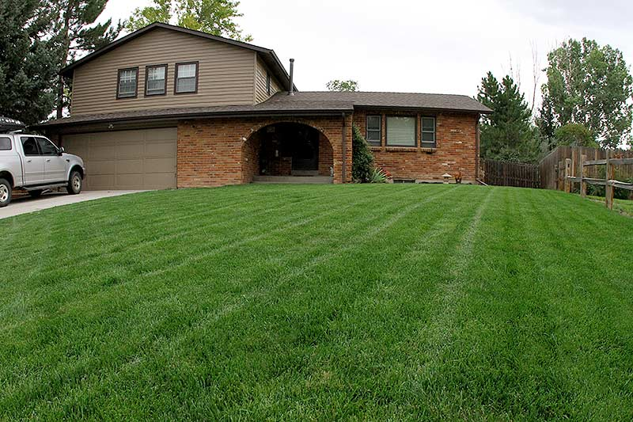
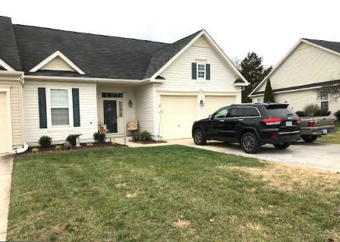
SCENARIO 1: Brown with Lawn Envy
My neighbor has the most beautiful lawn. What can I do to make mine look as nice as theirs?
What questions would you ask this client?
What resources will you use to research options?
What recommendations might you provide?

Slide 4
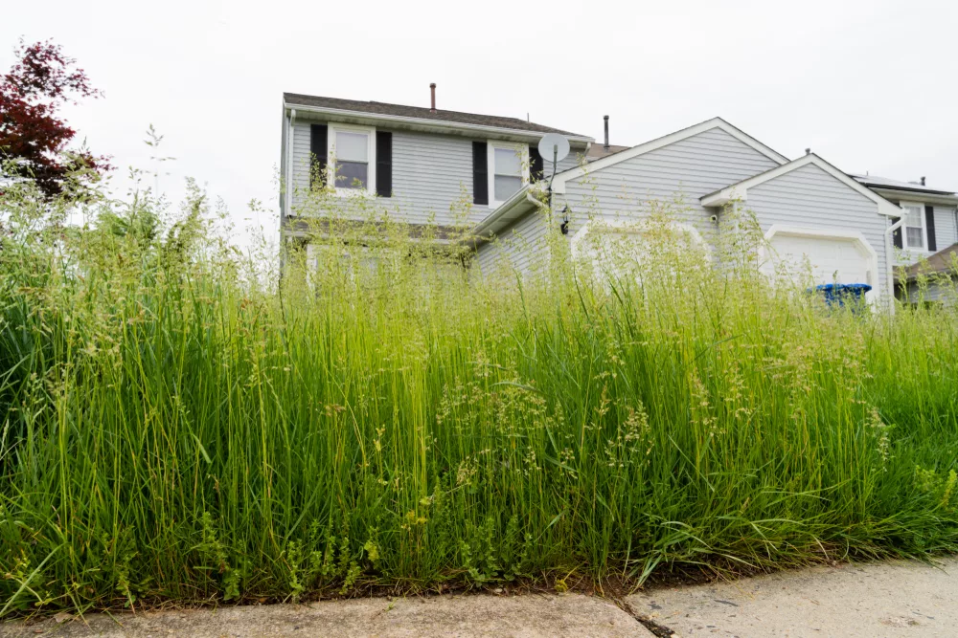
SCENARIO 2: Cutting it Close
My lawn got away from me during this last rainy spell. Is it OK to mow it?
What questions would you ask this client?
What resources will you use to research options?
What recommendations might you provide?

Slide 5
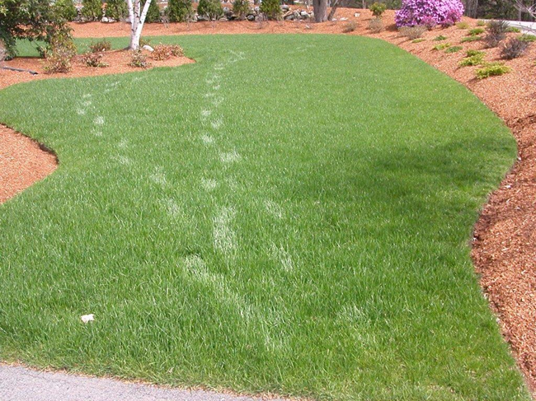
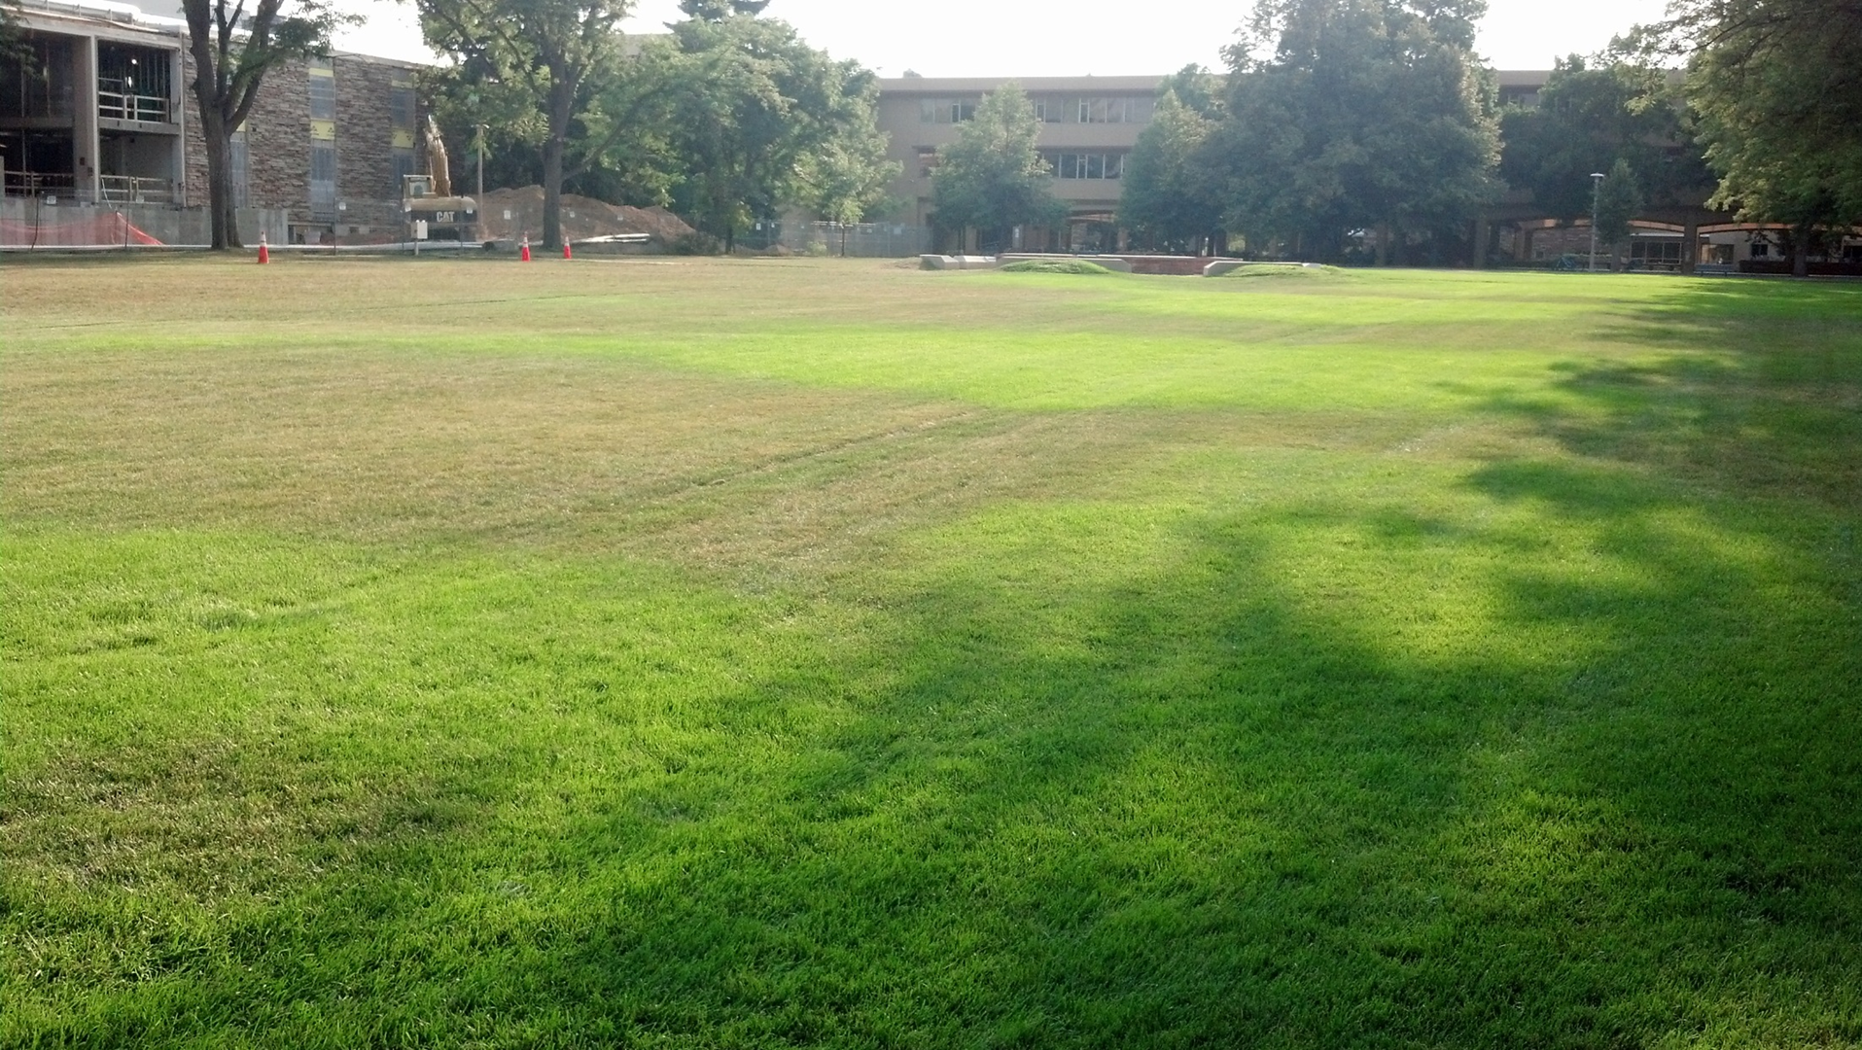
SCENARIO 3: Listen to your Lawn
I just moved to Colorado. Can you tell me the best way to water my lawn?
What questions would you ask this client?
What resources will you use to research options?
What recommendations might you provide?

Slide 6
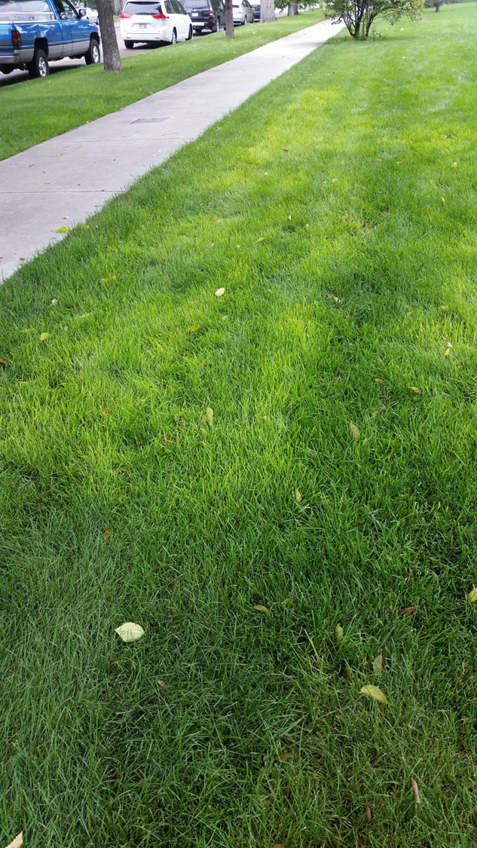
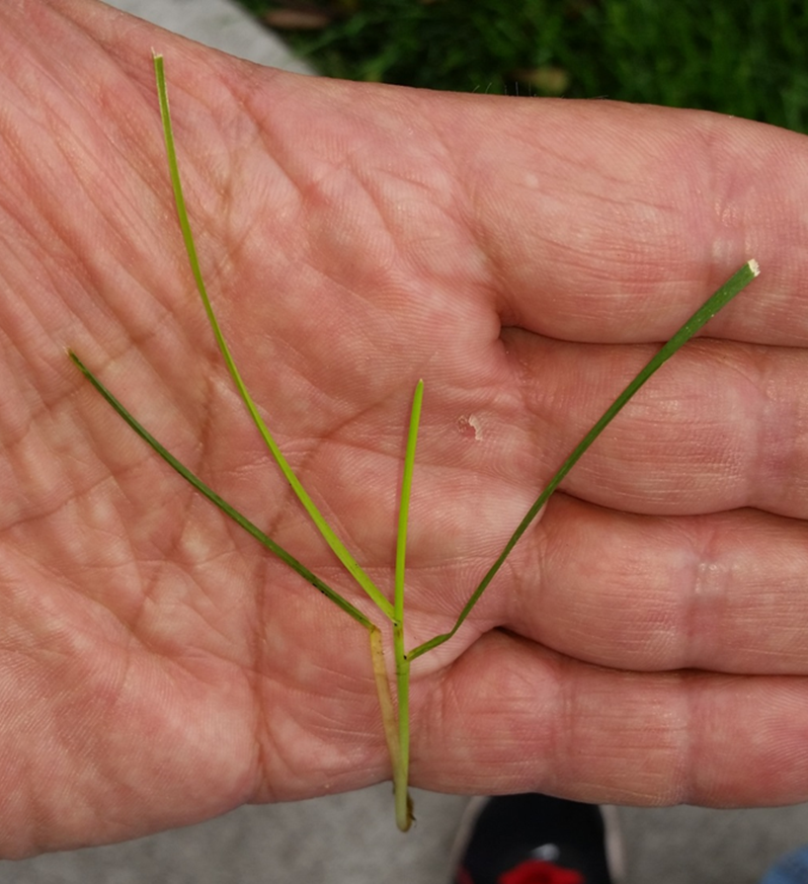
SCENARIO 4: The Green & Gold Lawn
My lawn is looking yellow in spots. How do I make it green again?
What questions would you ask this client?
What resources will you use to research options?
What recommendations might you provide?

Slide 7
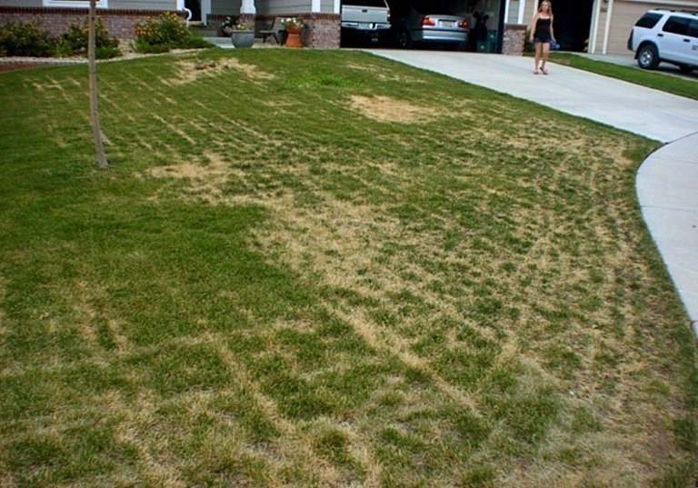
SCENARIO 5: Mower Mystery
After mowing I noticed mowing tracks of brown grass. Is the grass dead? What’s causing this and what can we do to fix and prevent it?
What questions would you ask this client?
What resources will you use to research options?
What recommendations might you provide?

Slide 8
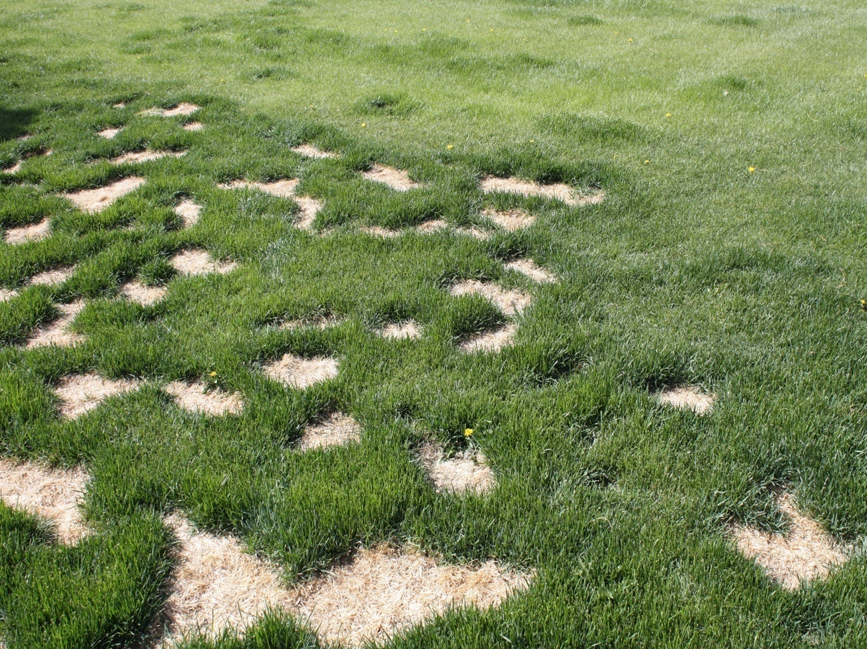
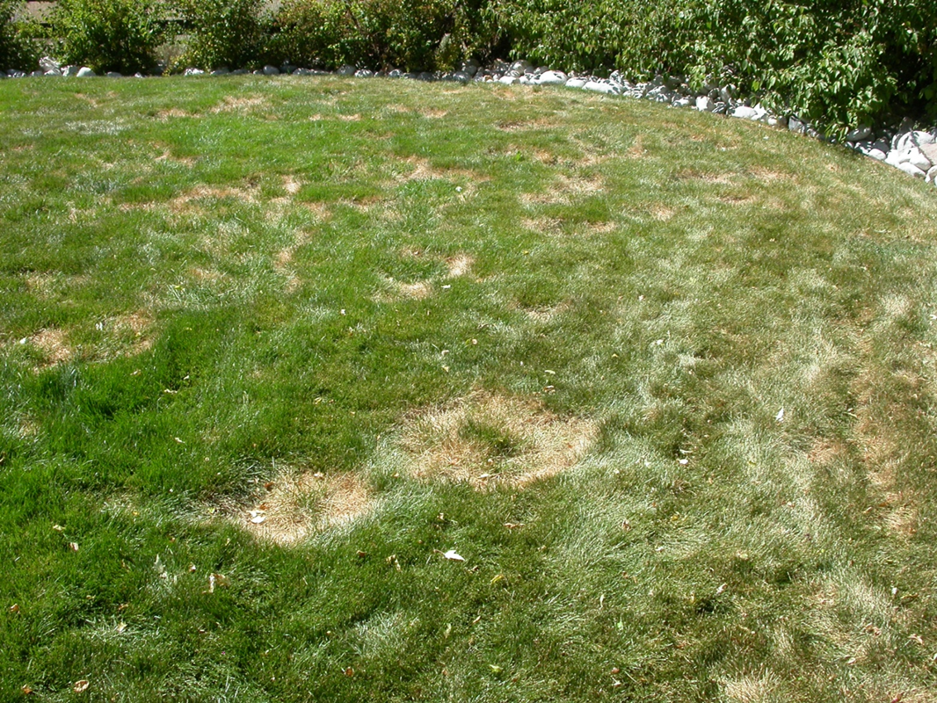
SCENARIO 6: Can you Spot the Problem?
Ack! What’s causing these brown spots in my lawn?
What questions would you ask this client?
What resources will you use to research options?
What recommendations might you provide?

Slide 9
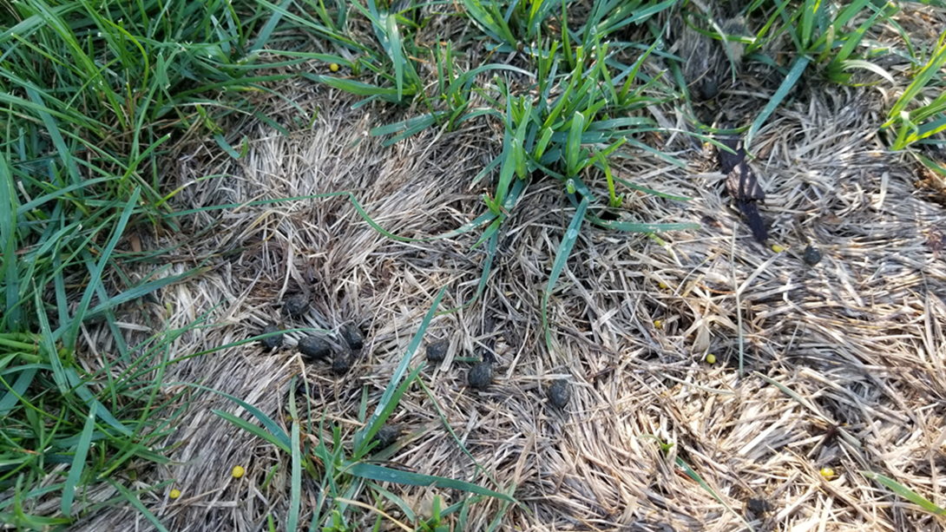
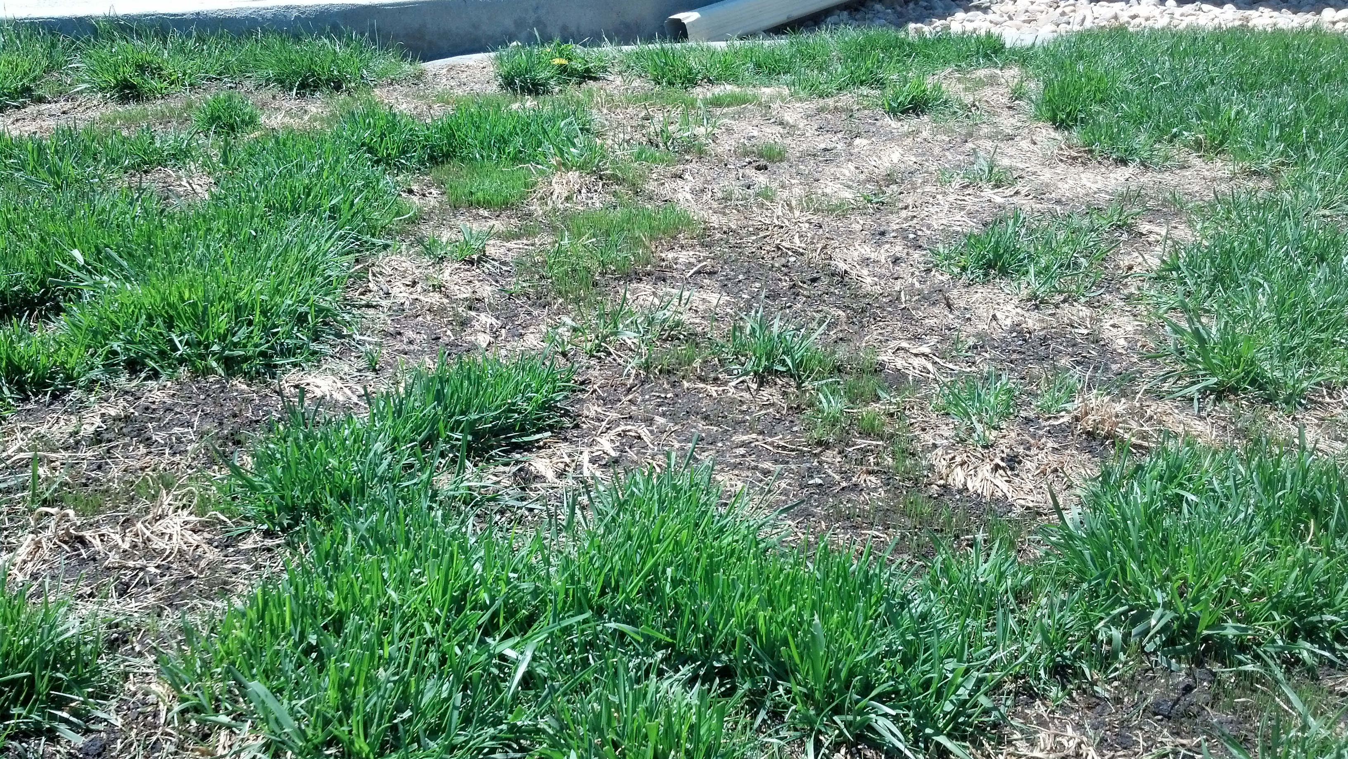
SCENARIO 7: A Hare-y Problem
My lawn appears to be dying and is almost bald is certain areas. I water regularly but it’s not working. What’s happening and how can I fix it?
What questions would you ask this client?
What resources will you use to research options?
What recommendations might you provide?

Slide 10
RABBIT DAMAGE IN THE LAWN - VIDEO

